Slide 1
1
Briefing session
HP07-2026DAI and HP08-2026SSP
Contracting, governance and policy unit
10 October 2025

Slide 2
2
Contract dates
Closing date: 24 November 2025
Contract Period:
HP07-2026DAI – 01 September 2026 to 31 August 2029 (3-year period)
(RFI_ HP07-2026DAI_ LAMA)
HP08-2026SSP – 01 September 2026 to 31 August 2029 (3-year period)
HP tenders' advertisement platforms
Available on NDoH website
www.health.gov.za
|Tenders| View Pharmaceutical Tenders
Available on National Treasury Website
www.treasury.gov.za
e-tenders

Slide 3
3
Tender Documents
Seven documents must be downloaded per tender and saved:
Bid pack
2) Bid Response Document (Excel)
Annexure A – Checklist (Excel)
Annexure B – Invoice requirements
PBD4.1 – Bidders’ Contact Details (Excel)
PBD9.1 Directors Categorisation Profile_Single Bid Entity (Excel)
PBD9.2 Directors Categorisation Profile_JV_Consortium_Partnership (Excel)
All Excel documents provided must be completed in excel and additionally be submitted as Set 3 in excel.
Note: Its compulsory to submit certified copies of Director’s/Owners identification documents

Slide 4
4
Submission of bid documents
Submit 3 sets of your bid
Set 1: Hard copy of Bid
(constitutes as the legal binding bid document)
Consisting of:
Bid Pack, completed
Annexure A Checklist, completed
PBD4.1 Bidders’ Contact Details, completed
PBD9.1 Directors Categorisation Profile_Single Bid Entity , completed
PBD9.2 Directors Categorisation Profile_JV_Consortium_Partnership , completed
(only completed PBD9.2 if applicable)
Final Bid Response, completed
Supporting documents as required in Bid Pack
All pages must be initialled by signatory using ink.
All relevant documents must be certified inclusive of certification date.
Bind your bid include tabs showing each section (same as bid file index)
Notes:
All SBD, PBD and Bid Response forms fully completed and printed, signed where indicated.
Remaining entry fields completed clearly in black ink, handwritten in capital letters.

Slide 5
5
Submission of bid documents
Document Submission
Set 2: Scanned mirror image of Set 1 (Hard Copy)
Saved on USB consisting off:
A folder for each section on Checklist (Annexure A)
Each section containing scanned signed documents
NB: Excel Bid Response (price),PBD4.1 PBD9.1, PBD9.2
Set 2 and Set 3 must be included on a single Universal Serial Bus (USB) Flash Drive / Storage Device and submitted in a sealed package with Set 1.
The full name and address of the bidder, including the return address of the bidder, the bid number and the closing date of the bid must be clearly indicated on the package.

Slide 6
6
Submission of bid documents
Document Submission
Set 3: Electronic version of bid (Excel Documents)
Completed Bid Response Document in Excel (not PDF)
Annexure A Checklist
PBD4.1 Bidders’ Contact Details in Excel (not PDF)
PBD9.1 Directors Categorisation Profile_Single Bid Entity in Excel (not PDF)
PBD9.2 Directors Categorisation Profile_JV_Consortium_Partnership in Excel (not PDF) if applicable.
Set 2 and Set 3 must be included on a single Universal Serial Bus (USB) Flash Drive / Storage Device and submitted in a sealed package with Set 1.
Package : The full name and address of the bidder, including the return address of the bidder, the bid number and the closing date of the bid must be clearly indicated on the package.

Slide 7
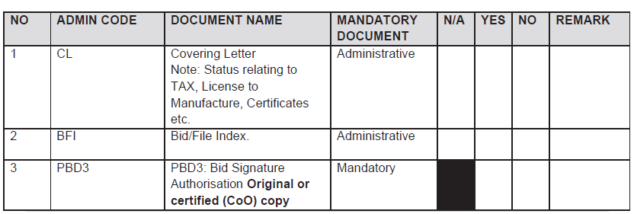
7
Submission of bid documents
All bid documents must be bound in a single file, with Tabs same as Index.
Index: All fields must be completed.
The absence of mandatory documents will impact the bid's responsiveness. Submission of bid documents is required unless a specific document is not applicable, in which case the bidder must explicitly indicate "N/A" and provide a justification for its exclusion. If a section is blacked out in the "N/A" field, it is not considered a valid selection option for the bidder.

Slide 8
8
Submission of bid documents
NOTE: Annexure A is a guidance document intended to facilitate compliance and support ease of bid submission. Each section must be read in conjunction with the relevant provisions of the Special Requirements and Conditions of Contract, as well as the General Conditions of Contract.
The NDoH reserves the right to request any administrative document or information for clarification if it does not change the substance of the bid. The bidder will have seven (7) working days to submit the requested document or information. Scanned copies must be identical to the hard copy submissions. In the event of any discrepancy, the hard copy shall take precedence.

Slide 9
9
Evaluation Criteria
Phases of evaluation
PHASE I | PHASE II | PHASE III | PHASE IV
Administrative evaluation | Product technical evaluation: Legal and regulatory | Price and Preference Points evaluation | Recommendation and Award
Bidders will be assessed for compliance with the mandatory administrative requirements | Bidders will be evaluated for compliance with the technical mandatory requirements, and the product will be evaluated for compliance to the specification. | Bidders will be evaluated w.r.t compliance to HDI and RDP Goals (Price and Preference Points) as per section 6 of the SRCC | Recommendation and award

Slide 10
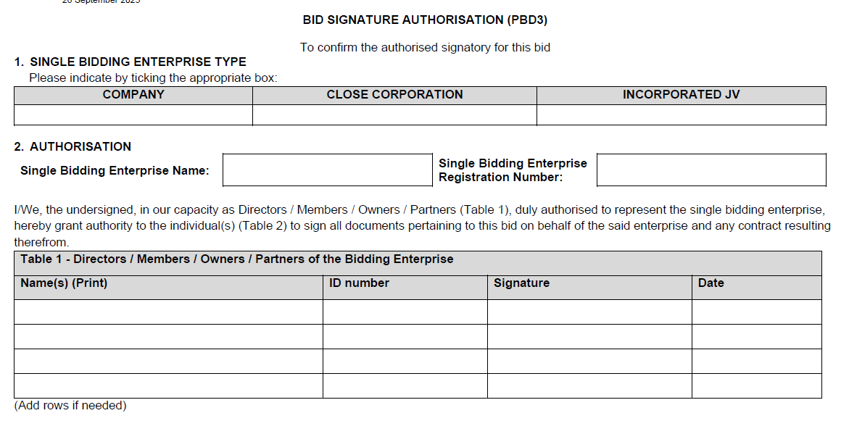
10
Administrative requirements (Phase I evaluation) Sec 4 of the SRCC
PBD3 AND PBD3.1: BID SIGNATURE AUTHORISATION
PBD3 is required for bids submitted by a single bidding entity.
PBD3.1 is required for bids submitted by a multi-entity bidding enterprise as described in section 4.3 of this SRCC.
The PBD3 or PBD3.1 must be the original template from the bid pack.
If a copy of this mandatory document is submitted, it must be certified by a Commissioner of Oaths as a true copy of the original. Failure to comply will render the bid non-responsive.
Notes:
Bidders are required to be registered on the CSD managed by National Treasury. The National Department of Health shall verify the bidder’s tax compliance status through the CSD.
Bidders are required to submit a Tax Clearance pin, issued by the South African Revenue Services (SARS).

Slide 11
11
Administrative requirements (Phase I evaluation) Sec 4 of the SRCC
Registration on the Central Supplier Database (CSD)
Tax Compliance Status
Bidders must be Tax compliant throughout bid validity period.
Submit a tax clearance pin.
Bid Submission – Hardcopy
All documents must be signed.
Sequence in bid file as per checklist (Annexure A).
Separated by section tabs.
Ensure USB included in bid file (containing Set2 & Set3)
Notes:
Bidders are required to be registered on the CSD managed by National Treasury. The National Department of Health shall verify the bidder’s tax compliance status through the CSD.
Bidders are required to submit a Tax Clearance pin, issued by the South African Revenue Services (SARS).

Slide 12
Administrative requirements : Joint Venture/Consortium/Partnerships (4.2)
In the case of a Consortium, Joint Venture (Incorporated or Unincorporated), and or Partnership an agreement is required
If the bidder is not the applicant as required in section 5, but any of the following conditions apply, a signed agreement between the bidder and the applicant must be included in the bid submission.
This applies in the following cases:
The bidder is not the applicant on the MRC, but both the bidder and the applicant are subsidiaries of a single legal entity (same parent company).
The bidder is not the applicant on the MRC, but either the bidder or the applicant is fully or partially owned by the other.
The bidder is not the applicant on the MRC, but the bidder and the applicant are part of a technology transfer arrangement.

Slide 13
The bidder is not the applicant but….
Company A (Parent company)
Enterprise B (Bidder)
AGREEMENT between
Enterprise B and Enterprise C
Enterprise C (Applicant)
Tender – Bid
The bidder is not the applicant on the MRC, but the bidder and the applicant are subsidiaries of a single legal entity (same parent company)

Slide 14
The bidder is not the applicant but….
Enterprise A
(Fully or Partly Own Enterprise B) – (Bidder)
Enterprise B (Applicant)
AGREEMENT between
Enterprise A and Enterprise B
Tender – Bid
The bidder is not the applicant on the MRC, but either the bidder or the applicant is fully or partially owned by the other.

Slide 15
The bidder is not the applicant but….
Enterprise A
(Bidder)
Enterprise B (Applicant)
The bidder is not the applicant on the MRC, but the bidder and the applicant are part of a technology transfer arrangement.
Technology transfer agreement
– In Progress
AGREEMENT between
Enterprise A and Enterprise B
Tender – Bid

Slide 16
Administrative requirements continue: Joint Venture/Consortium/Partnerships (4.3)
Entities specified in the signed agreement between the bidder and the applicant must submit all mandatory documents including the following:
SBD 1: Invitation to bid.
CSD Registration report
SARS Tax Clearance Pin
CIPC registration certificate
SBD 4: Declaration of interest
SBD5: The National Industrial Participation Programme
SBD 6(1)
PBD8: Declaration of compliance
SRCC and GCC
PBD 9.1: Directors & Owners
Applicant
Bidder
CSD Registration report
SARS Tax Clearance Pin
CIPC registration certificate
SBD 6(1)
PBD 9.1 Directors & Owners
PBD3.1: Bid Signature Authorisation
One document (PBD 3.1)
Signed by PBD9.1 directors of both entities
(Bidder and Applicant) appointing authorised tender signatory on behalf of bidding enterprise.

Slide 17
Legislative requirements (Phase II evaluation)
Licence Requirements:
If the product is deemed as a medicine by SAPHRA:
Bidder must be the holder of a licence to manufacture medicines issued in terms of section 22C (1)(b) of the Medicines Act, as amended.
Additionally, the bidder offering a product manufactured locally, must submit a copy of the licence to manufacture medicines as issued by SAPHRA to the local manufacturer. (If local manufacturer is not the bidder, and is indicated on the MRC)
In case of a joint venture all companies in the agreement must supply their licence to manufacture medicines issued in terms of section 22C (1)(b) Medicines Act, as amended.

Slide 18
18
Legislative requirements
(Phase II evaluation) continue
Medicines offered must be registered in terms of section 15 of the Medicines Act and must comply with the conditions of registration for the duration of the contract.
The bidder must be indicated as the applicant on the Medicine Registration Certificate.
A Certified copy of the Medicine Registration Certificate, must be included for all items offered.
Inclusive of any valid variation summary approved by SAPHRA for amendments on the Medicine Registration Certificate.
Annexure A (Conditions of Registration) will only be required for newly registered medicines.
When items are offered for products where a British Pharmacopoeia (BP) standard is specified, the bidder must declare that the product complied with and is manufactured according to the specified standard. Details of the manufacturer must also be provided.

Slide 19
Legislative requirements (Phase II evaluation) continue: Joint Venture/Consortium (4.3)
If the bidder is not the applicant as required in section 5, but any of the conditions apply, a signed agreement between the bidder and the applicant must be included in the bid submission (refer to section 4.3 of the SRCC).
The following legislative documents are mandatory for all parties involved in consortium, joint venture (incorporated or unincorporated), or partnership.:
A valid license to manufacture (bidder and applicant), along with certified copies as per section 5.1, must be provided for all parties involved in the bid.

Slide 20
Legislative requirements (Phase II evaluation) continue: Joint Venture/Consortium (4.3)
Continue:
An MRC (Medicines Registration Certificate) as per section 5, where one of the parties in the consortium, joint venture (incorporated or unincorporated) or partnership is identified as the applicant.
All parties in the Consortium/Joint Venture or Partnership must submit the legislative and mandatory requirements pertaining to this bid as indicated in the SRCC.
Refer to section 5 of the SRCC for further details pertaining to mandatory legislative requirements.

Slide 21
Authorisation Declaration
(Phase II evaluation)
Only the holder of a MRC issued in terms of the Medicines Act, may submit a bid.
The manufacturer, or other entity, as listed on the MRC, are considered external third parties:
If the holder of the Medicines Registration Certificate (MRC) is not the manufacturer of the product offered in this bid, a third-party manufacturer authorisation is required.
In such cases, the bidder must establish a formal legal agreement with the third-party manufacturer and submit a signed Authorisation Declaration (PBD1.2) from the relevant manufacturer as approved by SAPHRA which must be listed on the MRC.
Note: Authorisation Declaration can only be submitted by the approved third party as indicated on the registration certificate.

Slide 22
Preference for Locally Produced Products (Phase II evaluation)
To provide preference to locally produced products, the definition of a locally produced product will be limited to product formulation and conversion processes that use materials and components to manufacture medicines in the Republic of South Africa.
Included: Fill and finish of sterile products (including vaccines, large and small volume parenterals)
Excluded: Fill, finish, and packaging of products such as solids, liquids, sterile drops and semi-solid dosage forms.
Requirement:
The local site is listed as a Manufacturer on the MRC issued by SAHPRA.
The valid licence to Manufacture and all applicable annexures for the site are submitted.

Slide 23
23
Sample submission and product technical compliance (Phase II evaluation)
All bidders are required to submit samples including bidders who are currently supplying the NDoH with products to confirm the following:
Compliance with specifications as set out in the bid document/ item specification.
Compliance of the product with the requirements of the Medicines Act.
Samples must be submitted to both Health Facilities as indicated in the SRCC, before bid closure.
Samples received after Bid Closure will not be evaluated.
No samples must be sent to the National Department of Health.

Slide 24
24
Compliance to specifications (Phase II evaluation)
All medicines must be supplied in complete, patient-ready packaging in the specified pack size, using containers that are properly sealed and labelled in compliance with Medicines Act. Packaging must be in a ready-to-dispense format that does not require any manipulation, packing, or repacking by the dispensing healthcare workers.
The 28-day dispensing pack size is currently being phased out. In the case of medicines for chronic conditions, pack sizes suitable for a 30-day treatment cycle are required.
Where a 30-day dispensing pack size is advertised, and a 28-day dispensing provided, no conversion factor will be utilised. Evaluation will directly compare the 30-day dispensing pack size with other options offered and will not be considered as a specification deviation. All bidders are encouraged to participate in this tender.

Slide 25
25
Offering a bid price
(Phase III evaluation)
Price breakdown
The delivered price must be divided across five components:
Active Pharmaceutical Ingredients (API);
Formulation;
Packaging;
Logistics (this includes transportation, warehousing and distribution); and
Gross margin (remaining portion).
The sum of these categories must be equal to 100% of the delivered price for the line item.
Bid Prices may not exceed SEP Ex Man + VAT and Full SEP
Note: If no price breakdown or Foreign Currency is supplied in the Bid Response document, items will be deemed ineligible for CPA.

Slide 26
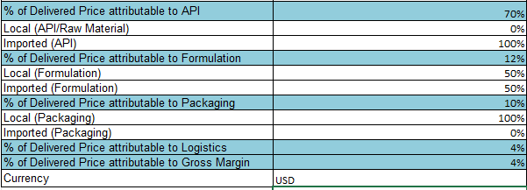
26
Offering a bid price
(Phase III evaluation) continue
Price breakdown
Example
Note: Please select the relevant currency by clicking on the dropdown arrow.

Slide 27
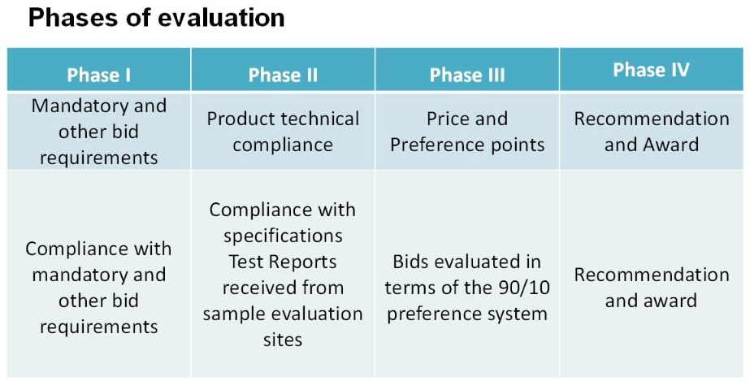
Preference Point Allocation – Phase III
Evaluated as per the requirements stated in bid document & SRCC

Slide 28
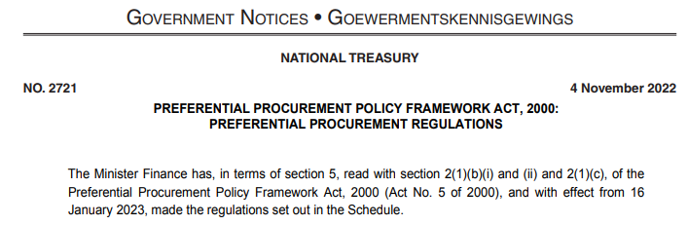
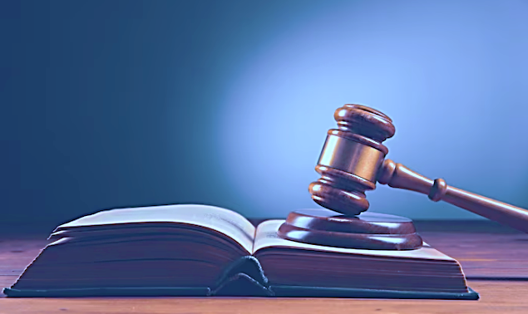
2022 Preferential Procurement Regulations
Placeholder for Public Procurement Bill / Public Procurement Act, 2024
2022 Regulations : Pre-determined B-BBEE Level scoring was removed for the Price and Preference points scoring system - 90/10 or 80/20
Preference points to be allocated for HDI Equity Ownership and compliance to specific goal/s i.e., Promotion of South African owned enterprises

Slide 29
Interpretation of 2022 Regulations
Organs of State may select preference points allocations and select own specific goal/s within the framework of the Regulations when:
“contracting with persons, or categories of persons,
historically disadvantaged by unfair discrimination
on the basis of race, gender and disability “
The NDoH specific goal was introduced through a formal BEC process
Goal : “Promotion of South African owned enterprises”
This tender
Price and Preference points : 90/10
Points allocated for HDI equity ownership and South African ownership in bidding enterprise (supported by individual share certificates).
B-BBEE certificate not required - not used as a measurement tool

Slide 30
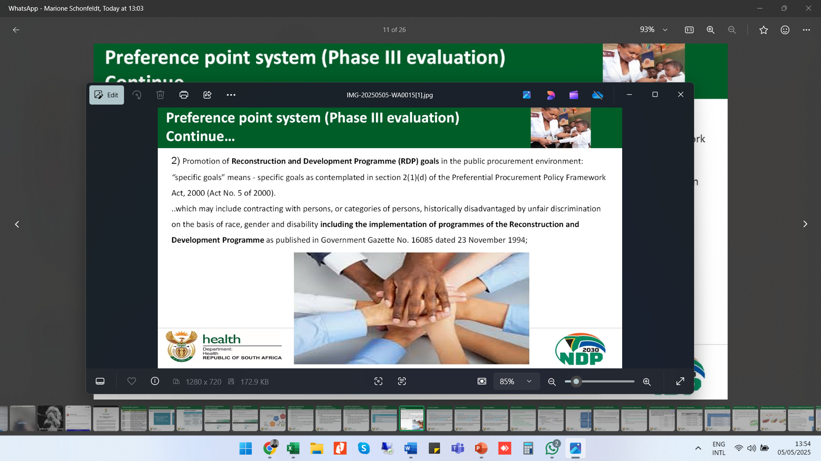
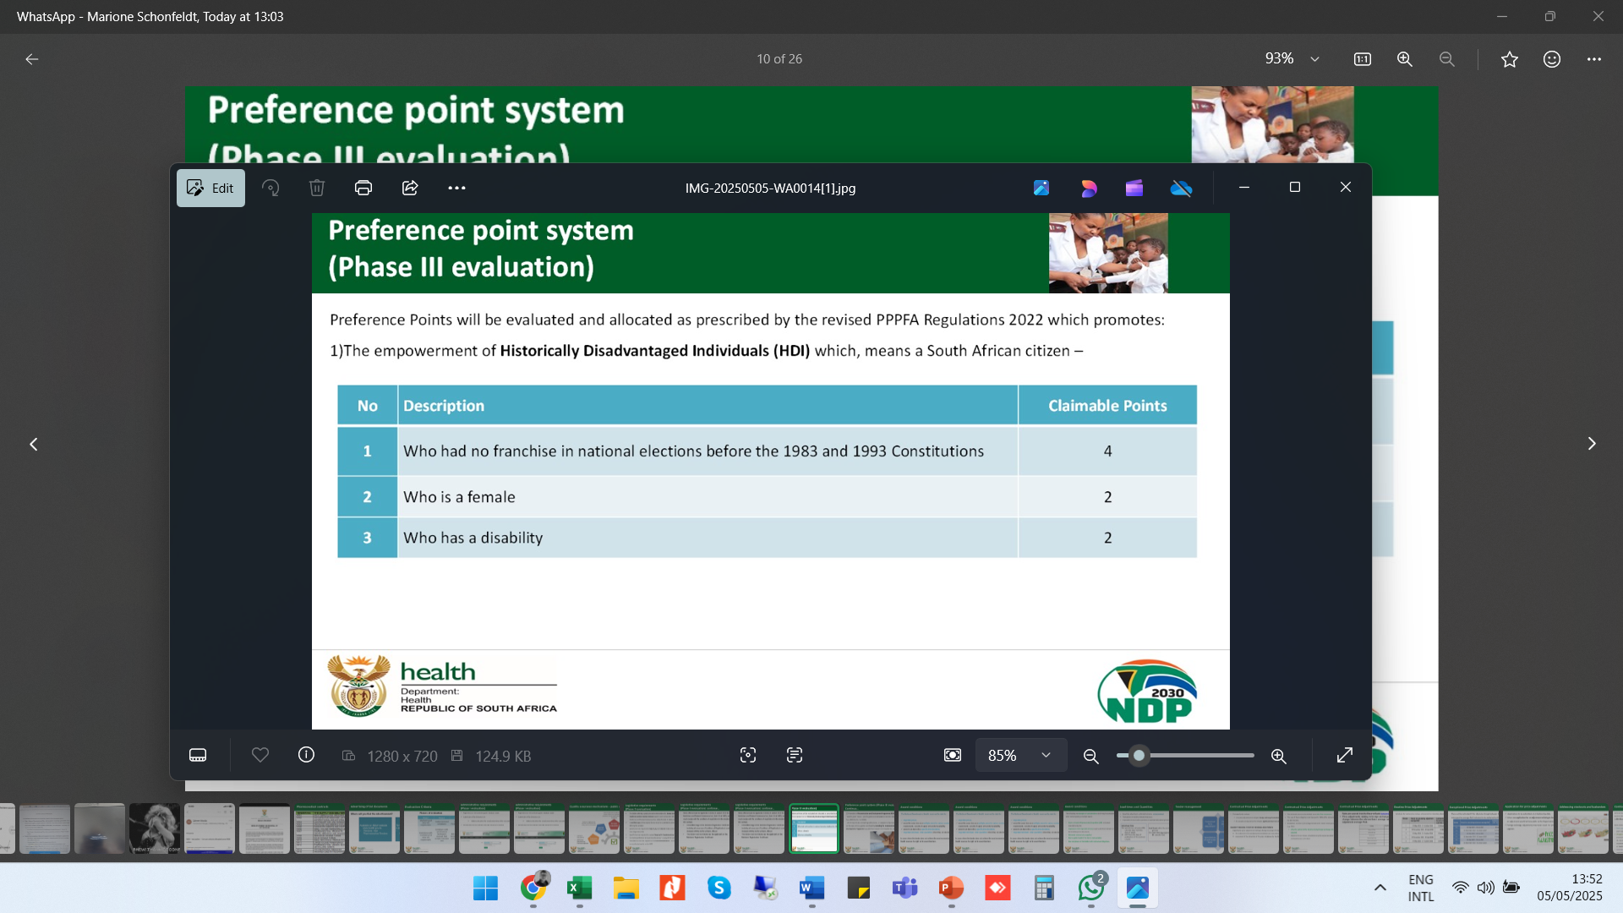
2022 Preferential Points Allocation – SBD6.1
AMD Mandate : SCM Circular 10 of 2022-2023 NDoH Implementation – 1 Feb 2023
“contracting with persons, or categories of persons,
historically disadvantaged by unfair discrimination
on the basis of race, gender and disability “
Specific Goal : Promotion of South African owned enterprises

Slide 31
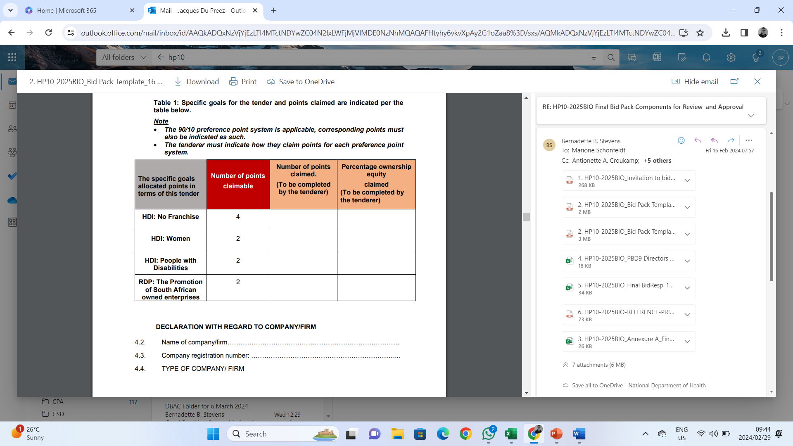
SBD 6.1 Claim Document
% Ownership = % of Point available
Criteria : HDI / any SA female / any SA person with a disability
(ownership supported by share certificate in the name of the individual)
Criteria : South African with ownership in bidding enterprise
(supported by share certificate in the name of the individual)

Slide 32
How to claim for HDI & RDP (ownership)
% Ownership held by HDI (No 1, 2, 3) = % of Point available (4, 2, 2)
Ownership of each qualifying HDI must be supported by a Share Certificate to translate into Preferential Points
Criteria : HDI (share certificate owner) born before 1994 / Any SA female / Person with disability
Specific Goal
Criteria : South African with ownership

Slide 33
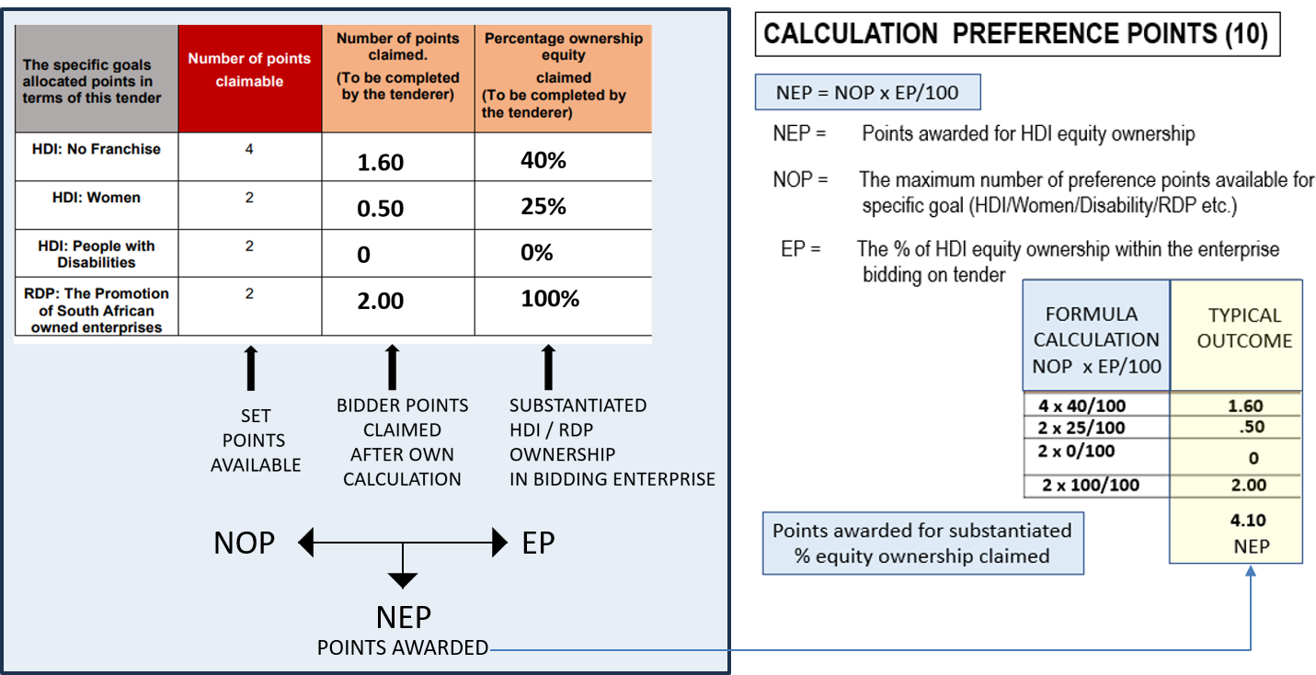
SBD 6.1 Claim Document - Calculation
% Equity Ownership x Points Available = Points Scored

Slide 34
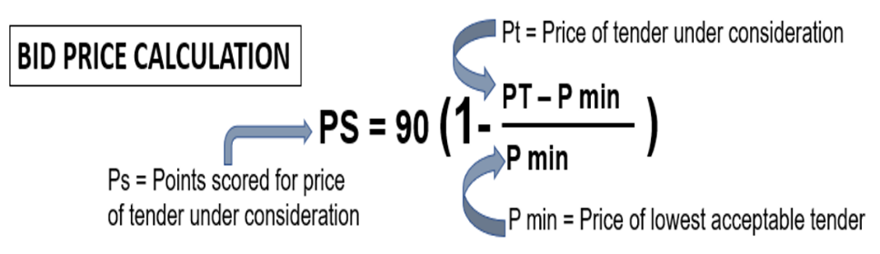
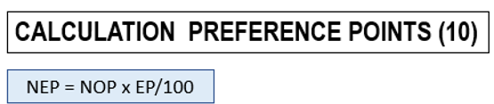
Points & Ranking of Bids Received - 90/10
Maximum 90 Points for Bid Price + Maximum 10 Points for HDI & RDP
TOTAL POINTS SCORED & DETERMINES RANKING OF BID
Notes:
Compliance to all specifications and regulations – all other bids prices measured against lowest and calculated accordingly, to obtain a score out of 90

Slide 35
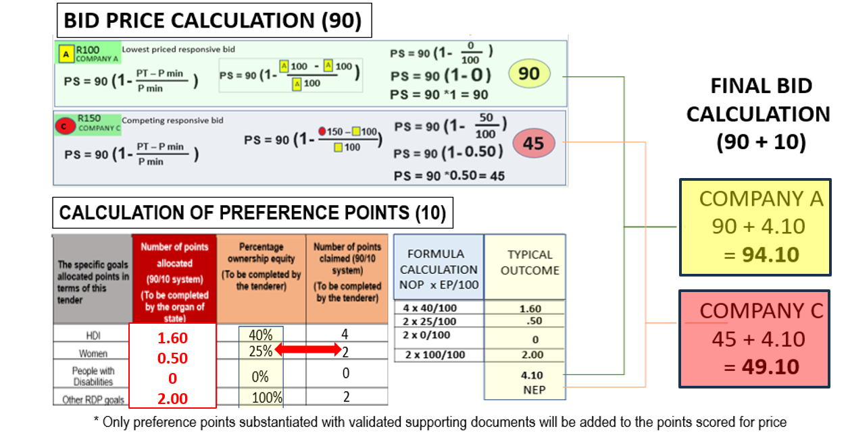
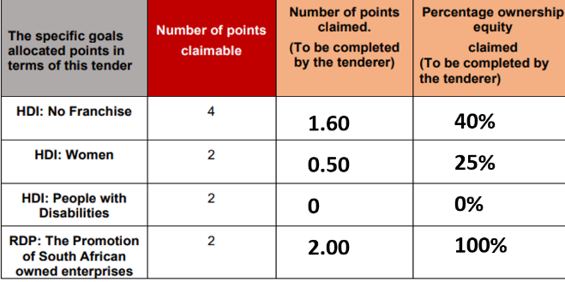
Bid Ranking
PRICE POINTS COMBINED WITH PREFERENCE POINTS = BID RANKING POINTS
PRICE
POINTS
POINTS
PREF

Slide 36
Other Ownership Claims (SBD 6.1)
PREFERENCE POINTS
Trusts & Ownership Schemes
HDI & RDP claims related to a Trust for qualifying individuals, allowed when:
they are listed in Trust Deed as Trustees and Beneficiaries
individuals are actively involved in the management of the Trust
trust ownership in bidding enterprise substantiated by share certificate.
Number of Trustees versus number of Trustees that are also Beneficiaries, will determine % allocation of points
Incorporated JV`s
HDI & RDP ownership claim, based on combined equity ownership of qualifying JV owners (proportional to stake in JV).
Partnerships & Consortiums
HDI & RDP ownership claim, allowed for qualifying participants, proportional to % participation/responsibility stipulated in official agreement
Substantiating evidence need to be presented for all entities/participants.

Slide 37
37
Award conditions
The National Department of Health reserves the right to:
Award the same item as a multiple award to various suppliers (two or more) to address high volume requirements, security of supply and product availability.
Negotiate prices and minimum order quantities and volumes.
Award an item with a specification deviation.
Refrain from applying conversion factors when a 30-day dispensing pack size is advertised, and a 28-day dispensing pack size is offered.
Combine the quantities and award only one item number, where applicable if an item is advertised as a single item but is included in a therapeutic class and is recommended for award within that class.
Only award one item in a procurement class. The item could be awarded to multiple suppliers as a split award.
In cases where the tender does not achieve the most economically advantageous price, the National Department of Health reserves the right not to award that item.

Slide 38
38
Award conditions continue
The following are examples of considerations which may be considered when contemplating a multiple award:
Source of Active Pharmaceutical Ingredient (API) and actual manufacturing site;
Capacity to meet expected demand as per published estimates in the Excel Bid Response Document;
Estimated volume to be supplied;
Risk to public health if the item is not available;
Past compliance of the bidder with contractual obligations.

Slide 39
39
Award conditions continue
Therapeutic Classes (SRCC – section 20.2)
Therapeutic class is defined as a group of medicines which have active ingredients with comparable therapeutic effects. Medicines in a therapeutic class may or may not belong to the same pharmacological class, may differ in chemistry or pharmacokinetic properties, and may possess different mechanisms of action, result in different adverse reaction, have different toxicity, and drug interaction profiles.
In most cases, these medicines have close similarity in efficacy and safety profiles, when administered in equipotent doses for a specific indication.

Slide 40
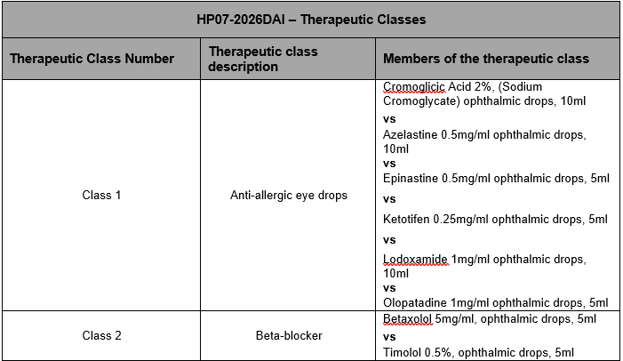
40
Award conditions continue
HP07-2026DAI

Slide 41
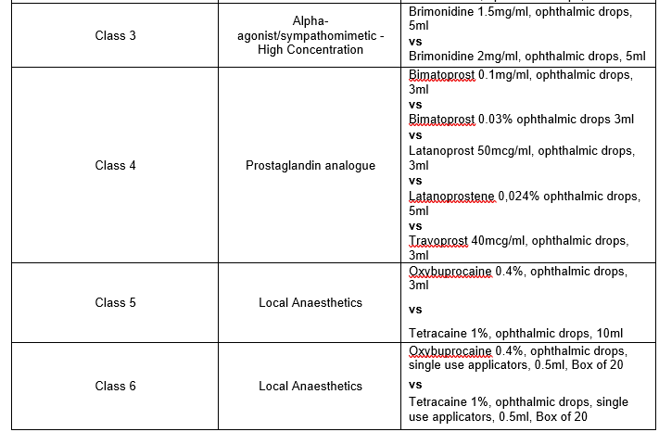
41
Award conditions continue
HP07-2026DAI continue:

Slide 42
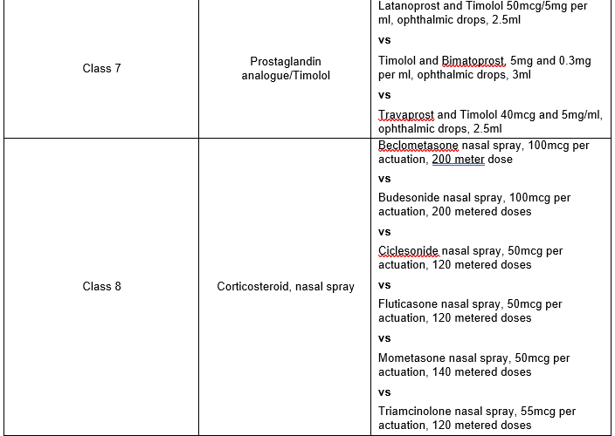
42
Award conditions continue
HP07-2026DAI continue:

Slide 43
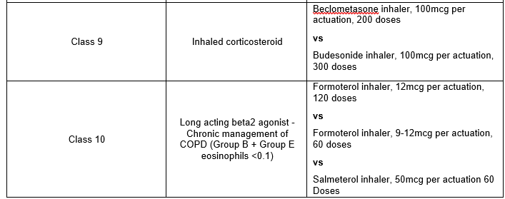
43
Award conditions continue
HP07-2026DAI continue:

Slide 44
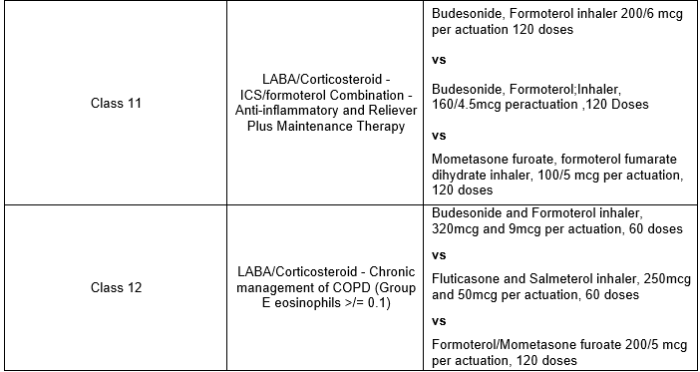
44
Award conditions continue
HP07-2026DAI continue:

Slide 45
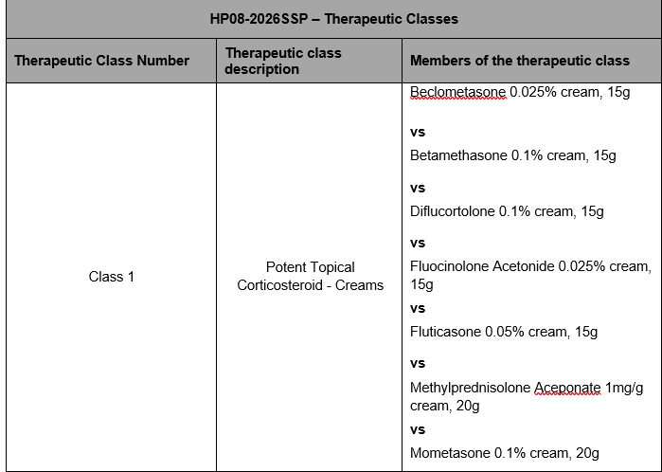
45
Award conditions continue
HP08-2026SSP

Slide 46
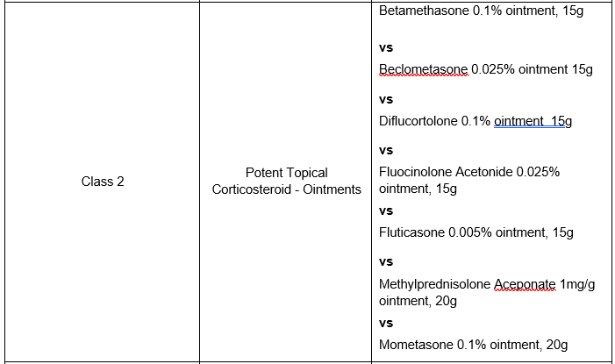
46
Award conditions continue
HP08-2026SSP continue:

Slide 47
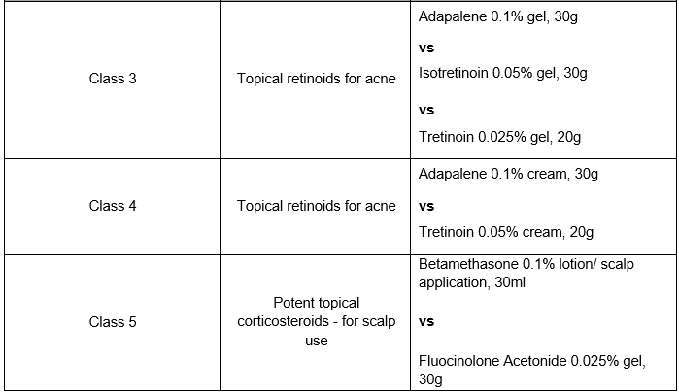
47
Award conditions continue
HP08-2026SSP continue:

Slide 48
48
Award conditions continue
Source documents
The Policy for Classifying Medicines into Therapeutic Classes for Purposes of Therapeutic Interchange
https://www.health.gov.za/wp-content/uploads/2021/08/Therapeutic-Interchange-Policy_July2021_final.pdf
A single member of the class may be awarded.

Slide 49
49
Award conditions continue
Procurement Class HP07-2026DAI and HP08-2026SSP:
A procurement class is a grouping of medicines with the same active ingredient but different pack sizes, strengths, formulations, or dosage forms. It is used when market competition is limited, or specific product requirements are not clinically essential. Placing these items in a procurement class promotes fair comparison, competition, and economies of scale, while allowing flexibility to adapt to market availability and ensure continued access. Only one item specification is awarded within a procurement class, though the award may be split between suppliers if needed. During price evaluation the cost per tablet will be considered

Slide 50
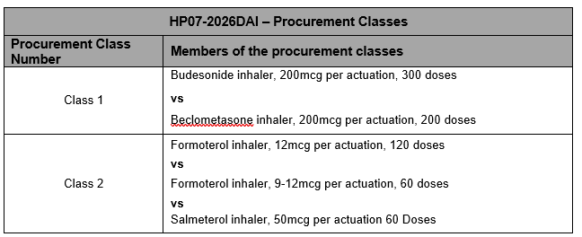
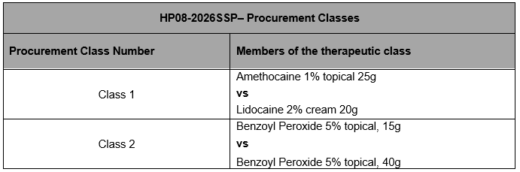
50
Award conditions continue
Procurement Class HP07-2026DAI and HP08-2026SSP:

Slide 51
51
Contractual Price Adjustment (CPA) - Section 22 of the SRCC
Only the portion of the bid price facing foreign exchange risk will be adjusted.
Adjustments calculated using the original awarded contracted price as the base.
The percentage change between a base average rate of exchange (RoE) and an adjustment average RoE.
Rates are sourced from the Reserve Bank (www.resbank.co.za).
Where no application for an adjustment relating to foreign exchange has been received and such an adjustment would be favourable to the Department, this will be implemented automatically.
Foreign exchange adjustments may never result in a price exceeding the current Single Exit Price.
Additional CPA at the start of the contract has been implemented please refer to the CPA Exceptional section 22 of the SRCC for further detail.

Slide 52
52
Offering a bid price
(Phase III evaluation) continue
Price breakdown
In order to be eligible for Contractual Price Adjustments all sections of the below example inclusive of currency must be completed.
Note: Please select the relevant currency by clicking on the dropdown arrow.

Slide 53
53
Lead times and Quantities
Initial lead time
This period may not exceed 75 calendar days from the date of award.
NOT from the date of publication of the contract circular or 1st order received.
Lead time
(within the contract period)
This lead time may not exceed 14
calender days
Quantities advertised = estimated volumes, not guaranteed.
Fluctuations in monthly demand may occur.
Proposed minimum order quantities should facilitate delivery directly to facilities.

Slide 54
54
Orders
Only orders made on an official, authorised purchase order are valid.
Suppliers are required to acknowledge receipt of all purchase orders received from participating authorities, in a manner stipulated by the relevant participating authority.
Changes to any quantities ordered may only be made upon receipt of an amended purchase order.
The Participating Authorities reserve the right to cancel orders where the lead time exceeds the delivery lead time specified in the contract.
In cases where an order is received which appears to be irrational or misaligned with estimates, the contracted supplier must liaise with the relevant Participating Authority prior to processing the order.

Slide 55
55
Supplier Performance Management
The National Department of Health, in collaboration with the Participating Authorities, will monitor the performance of contracted suppliers in terms of this contract, including but not limited to the following:
Compliance with delivery lead times;
Compliance with delivery in full as per the purchase order;
Percentage of orders delivered on time and in full;
Compliance with reporting requirements according to reporting schedule and reporting mechanism; and
Attendance of compulsory quarterly meetings
Contracted Suppliers may be required to present continuous improvement initiatives aimed at improving efficiencies in the supply chain to benefit both suppliers and the Department

Slide 56
56
Supplier Performance Management
Reporting requirements
As a minimum, suppliers will be required to submit the following:
All transactional data relating to orders;
A monthly age analysis;
Production pipeline data and forecast including:
Number of units of the item available (stock on hand);
Number of units of the item in Quality Assurance, awaiting release;
Number of units of the item in the current month’s production plan.
Status of outstanding orders.

Slide 57
57
Continuity of supply
Suppliers are required to maintain sufficient buffer stock to meet at least two months demand for all items, aligned with the needs of participating Authorities.
Allowances for a reduced yet appropriate buffer stock will be made for the last two (2) months of the contract as agreed upon between NDoH and the contracted supplier.
Contractors must inform the National Department of Health at first knowledge of any circumstances that may result in interrupted supply, including but not limited to:
regulatory action which may impact on their GMP status or that of entities on which they are reliant;
any anticipated problems associated with the availability of active pharmaceutical ingredient (API);
industrial action;
challenges with manufacturing pipeline;
any other supply challenges.

Slide 58
58
Continuity of supply
Contracted Suppliers must direct official communication relating to continuity of supply to stockalert@health.gov.za, as well as Participating Authorities;
All official communication must include detail of corrective actions taken by the contracted supplier to ensure continuity of supply.
It is the responsibility of the contracted supplier to ensure continuous availability and supply of contracted items.
If the contracted supplier is unable to supply, the contracted supplier will source alternative product of acceptable quality and up to the same quantity as required in terms of the contract.
The substitute item will be supplied at the current price of the contracted item.

Slide 59
Continuity of supply as per updated SRCC
Supplier Inability to Supply (Less than 6 Months):
If a contracted supplier in a split/multiple award cannot supply an item for up to six months, the NDoH can reallocate volumes to another contracted supplier temporarily.
Supplier Inability to Supply (More than 6 Months):
If a supplier cannot supply an item for more than six months, the NDoH can cancel the contract as per Section 23 of the GCC (Clause 21.2).
Penalties for Delays: Suppliers may face penalties for exceeding the contractual lead time as per Section 22 of the GCC.
Procurement Outside the Contract: Participating Authorities can purchase outside the contract if the contracted item is not available within the 14-day lead time. The cost difference between the contracted supplier's item and the alternative item will be borne by the contracted supplier.

Slide 60
60
Shelf life
Unless MCC or SAHPRA, has approved a shorter shelf life, products must have a shelf-life of at least 12 months upon delivery.
Contracted suppliers may apply in writing to PAs to supply a product with a shorter shelf life provided that:
Applications are accompanied by an undertaking that such short-dated products will be unconditionally replaced or credited before or after expiry; and
applications are approved before execution of orders; and
upon notification of remaining expired stock such products will be collected by the supplier at their own cost; and
failure to collect the products within 30 days after written notification to the supplier will result in the disposal of the product by the PA for the account of the supplier.
Any PA may, without prejudice, decline to accept product with a shelf-life of less than 12 months.

Slide 61
61
Tips for Completing the Bid Document
Bid Response Document - Adobe Reader 9 or later must be used.
This is available as a free download.
If you have difficulty in downloading / opening or saving documents, first try opening the document online then saving from there to your computer. Add your company name to filename
Only start completing the document when downloaded and saved. Highlight existing fields to avoid missing any
If your Adobe does not allow to complete electronically, complete the document by hand, using black ink.
Fields can be corrected by overtyping – note that some fields could be “prefilled” from a previous entry
Complete all fields, print and save, confirm correct, then complete any remaining empty fields, then sign and scan.
Ensure that all fields in the final electronic copy correspond with the final printed copy (as latter is the legal bid)

Slide 62
62
Tips for Completing the Bid Document
Excel Document
Use Ms Excel® 2007 or later
Complete ALL response fields in Excel for items on which bids are submitted
Note carefully what unit is asked for: the estimates are expressed in these units
Submit price according to this unit Certain fields are restricted to numbers only to avoid you entering spaces, commas or letters DO NOT make any changes to item numbers, item specifications or estimates or add / duplicate columns
If you want to make additional offer on the same product, submit another Bid Response Document for that item – clearly naming it Alt_offer(s)

Slide 63
63
Final checks
Finalizing bid document
Double-check :
Accuracy and completeness of the completed document.
All bid prices are for the correct unit and are VAT-inclusive.
Print out the BRD
Compare the printed BRD with the electronic version (Ensure that all items are printed - printed version is the legal copy)
Sign every page of hard copy
Save and submit electronic completed BRD in Excel on a USB as Set 3, and also;
Save and submit a PDF copy of the signed BRD on the USB as Set 2.
Submission of complete set at NDoH bid box (Site indicated in SBD1)
Bidders are strongly advised to complete the Bid Box Register when submitting their bid.

Slide 64
64
Challenges found in previous tenders:
CD/USB either corrupt or no data saved (Ensure to check that the data is available and accessible);
Certification of relevant documents was found to be copies and not dated (Ensure it is an original stamp from a Commissioner of Oath and dated);
Compulsory bid documents not signed, if signed a copy was submitted (Ensure compulsory documents are signed in black wet ink in spaces provided)
Bidders do not initial each page in black wet ink (Ensure to check the full bid documents prior to submission that all relevant initials and signatures required are present)
Submission of 3rd Party Authorisation letters as indicated on the Medicine Registration Certificate is compulsory (Please submit the relevant Authorisation. If it deviates from the MRC kindly provide a detailed explanation for the reasons thereof)
Submission of the MRC Variation Summary approved by SAPHRA amending changes on the MRC (MRC must be submitted to verify amendment)
Legible electronic copy of the Package insert as part of Set 2 is a requirement
Naming convention of the electronic files is not in accordance with Annexure A Checklist.
Incorrect MRC Certificate supplied in bid pack.
Licence to Manufacture omitted from bid pack.

Slide 65



65
The centralised toll-free corruption hotline - 0800 701 701
Read more: http://www.southafrica.info/services/government/hotline-anticorruption.htm#.Vekno0YbJzA#ixzz3kkAPmrmo

Slide 66
66
Thank You
Thank you for attending this Online Briefing Session
The End
Question can be emailed to tenders@health.gov.za

