Slide 1
1
Clarity on requirements of Sections 4.2 and 5.1.2
Contracting, governance and policy unit

Slide 2
2
Legislative requirements
(Phase II evaluation)
Medicines offered must be registered in terms of section 15 of the Medicines Act and must comply with the conditions of registration for the duration of the contract.
The bidder must be indicated as the applicant on the Medicine Registration Certificate.
A Certified copy of the Medicine Registration Certificate, must be included for all items offered.
Inclusive of any valid variation summary approved by SAPHRA for amendments on the Medicine Registration Certificate.
Both MRC and relevant variation summary must be submitted.
Annexure A (Conditions of Registration) will only be required for newly registered medicines.
If the bidder is not the applicant, refer to section 5 of the SRCC for Consortium/ Joint Venture or Partnerships agreements.

Slide 3
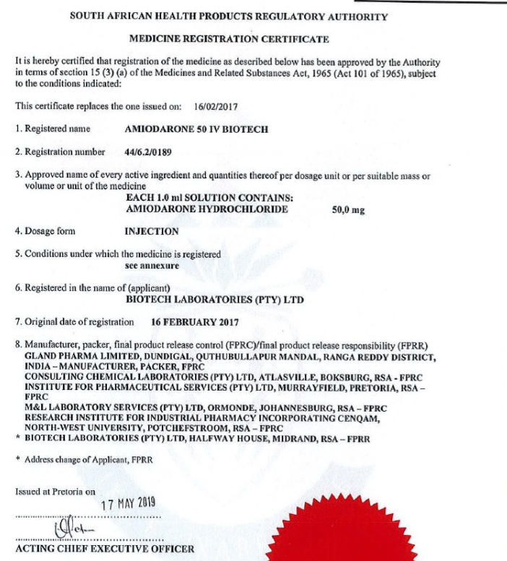
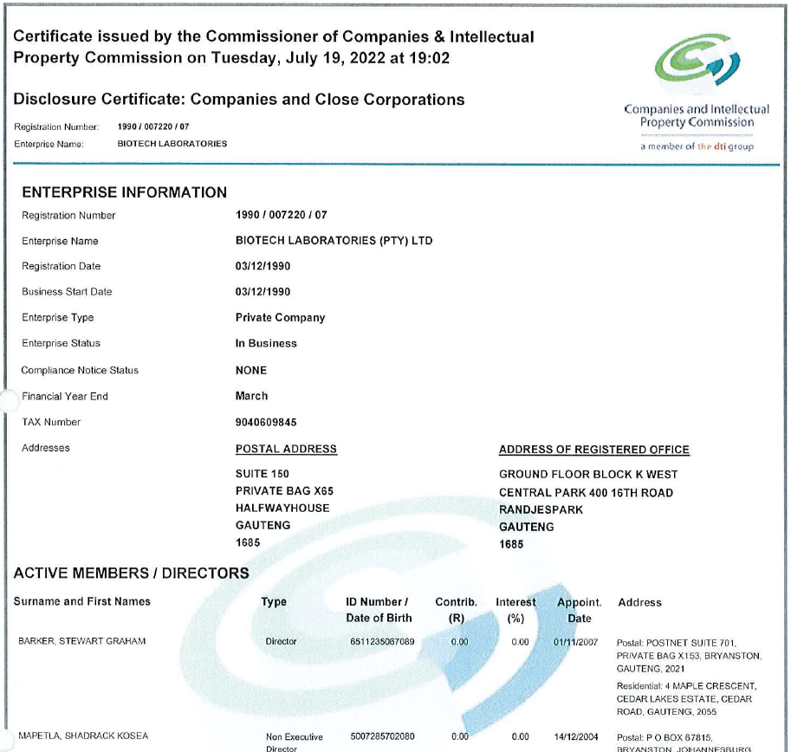
What does it mean that the bidder must be the applicant?

Slide 4
Administrative requirements : Joint Venture/Consortium/Partnerships (4.2)
In the case of a Consortium, Joint Venture (Incorporated or Unincorporated), and or Partnership an agreement is required
If the bidder is not the applicant as required in section 5, but any of the following conditions apply, a signed agreement between the bidder and the applicant must be included in the bid submission.
This applies in the following cases:
The bidder is not the applicant on the MRC, but both the bidder and the applicant are subsidiaries of a single legal entity (same parent company).
The bidder is not the applicant on the MRC, but either the bidder or the applicant is fully or partially owned by the other.
The bidder is not the applicant on the MRC, but the bidder and the applicant are part of a technology transfer arrangement.

Slide 5
The bidder is not the applicant but….
Company A (Parent company) example: Khadija Global
Enterprise B (Bidder):
Khadija Pty (Ltd)
AGREEMENT between
Enterprise B and Enterprise C
Enterprise C (Applicant): Khadija Manufacturing
Tender – Bid
  The bidder is not the applicant on the MRC, but the bidder and the applicant are subsidiaries of a single legal entity (same parent company)

Slide 6
The bidder is not the applicant but….
Enterprise A: Ephodia Pty (Ltd)
(Fully or Partly Own Enterprise B) – (Bidder)
Enterprise B (Applicant): Marione RSA Pty (Ltd)
AGREEMENT between
Enterprise A and Enterprise B
Tender – Bid
  The bidder is not the applicant on the MRC, but either the bidder or the applicant is fully or partially owned by the other.

Slide 7
The bidder is not the applicant but….
Enterprise A: Bernadette RSA
(Bidder)
Enterprise B:
Mandie USA
(Applicant)
  The bidder is not the applicant on the MRC, but the bidder and the applicant are part of a technology transfer arrangement.
  The bidder may reflect as a manufacturing site on the applicant MRC
Technology transfer agreement
– In Progress
(purpose of local manufacturing)
AGREEMENT between
Enterprise A and Enterprise B
Tender – Bid

Slide 8
When does Section 4.2 apply?
In the case of a Consortium, Joint Venture (Incorporated or Unincorporated), and or Partnership an agreement is required
Two or more legal entities enter into a formal agreement for the purpose of jointly bidding in response to a state tender, to supply a product to the state for the full duration of the contract, if awarded.
The agreement does not involve a transfer of applicancy; the applicant listed on the MRC will remain unchanged.
Neither the bidder nor the applicant will submit a separate bid for the specified item — they will not compete individually or against their joint bid.
A pre-existing relationship exists between the parties, which will continue throughout the contract period.
The bidder will eventually be listed as a manufacturing site on the MRC, in the context of a technology transfer arrangement.

Slide 9
When does Section 4.2 not apply?
The requirement does not apply to the following types of arrangements unless there is a parent–subsidiary relationship or partial ownership between the entities:
Marketing agreements between separate legal entities
Distribution agreements between separate legal entities
Transfer of applicancy involving unrelated entities, unless the parties are subsidiaries or are in the process of a formal acquisition in which case an agreement must still be submitted.

Slide 10
What is the difference….
Joint Venture Incorporated
Consortium, Joint Venture (Unincorporated), and or Partnership
Has agreements between legal entities that NDOH must have sight of for the purpose of participating on state contracts – Valid for the duration of the contract period
Exist for the purpose of participating in state tenders – remain two or more legal entities – no new company registered
Exist for the purpose of participating in state tenders – form a new legal entity (registered on CIPC and CSD) the – new entity is the BIDDER

Slide 11
What is usually included in these types of agreements?
In the case of a Consortium, Joint Venture (Incorporated or Unincorporated), and or Partnership an agreement is required
Purpose & Scope – Objectives, business goals, and scope of collaboration.
Roles & Responsibilities – Defined roles of each party, including responsibilities for pharmacovigilance, recalls, and payments.
Contributions & Liabilities – Each party’s inputs (e.g. capital, IP, assets) and legal obligations.
Governance Structure – Management setup, decision-making processes, and distribution of control.
Authorized Signatories – Individuals legally empowered to sign bid documents on behalf of the group.
Participation Percentages – The share/ownership or participation level of each member.
Agreement Duration & Termination – Timeframe of the agreement, renewal terms, and procedures for termination (including implications on the contract).
Other Relevant Details – Any additional information required to fully understand the arrangement.

Slide 12
Administrative requirements continue: Joint Venture/Consortium/Partnerships (4.2)
In such cases, the following documentation must be included with the bid:
A certified copy of the signed agreement between the bidder and the applicant, outlining the terms of their relationship.
PBD 3 must be completed, and the appointed representative must be authorised to act on behalf of the consortium, joint venture (incorporated or unincorporated), or partnership.
Additionally, all parties involved in the consortium, joint venture (incorporated or unincorporated) or partnership must submit the relevant legislative and mandatory documentation as required for this bid, as specified in the SRCC (Special Requirements and Conditions of Contract).

Slide 13
Administrative requirements continue: Joint Venture/Consortium/Partnerships (4.2)
Each entity (participant) in the consortium joint venture (incorporated or unincorporated), or partnership must submit all mandatory documents including the following:
Tax Compliance Status (TCS) PIN.
Proof of Central Supplier Database (CSD) registration (CSD report).
While additional documents issued by the Companies and Intellectual Property Commission (CIPC) may be submitted, the inclusion of these two specific forms is mandatory.
Registration certificate (Form CoR 14.3)
Notice of change of Directors (Form CoR 39)

Slide 14
Legislative requirements (Phase II evaluation) continue: Joint Venture/Consortium (4.2)
An agreement is required for multiple enterprises combined in a bid.
The following legislative documents are mandatory for all parties involved in consortium, joint venture (incorporated or unincorporated), or partnership.:
A valid license to manufacture (bidder and applicant), along with certified copies as per section 5.1, must be provided for all parties involved in the bid.
An MRC (Medicines Registration Certificate) as per section 5, where one of the parties in the consortium, joint venture (incorporated or unincorporated) or partnership is identified as the applicant.
All parties in the Consortium/Joint Venture or Partnership must submit the legislative and mandatory requirements pertaining to this bid as indicated in the SRCC.
Refer to section 5 of the SRCC for further details pertaining to mandatory legislative requirements.

Slide 15
What to do if the above does not apply but you are busy with a transfer of applicancy:
Current MRC holder sold dossier to Future MRC holder
Future MRC holder has submitted a change of applicancy to SAHRPA
Awaiting SAHPRA approval
Scenario 1: Applicancy transfer completed by the time of bid closure – proceed as normal the bidder is the applicant
Scenario 2: Applicancy transfer NOT completed by the time of bid closure – Current MRC holder MUST submit the bid
= bidder is the applicant

Slide 16
What will happen if the contract is awarded to Current MRC holder Section 30 SRCC:
Contracted suppliers must inform the NDoH in writing if:
They plan to merge with or be acquired by another entity or procure/sell the dossier for an item on contract.
They intend to cede the contract or any contracted item to another supplier.
For cession of a contract:
A formal written request must be submitted to the NDoH at least 3 months before the proposed effective date.
The NDoH may accept, reject, or cancel the contract based on the request.
Suppliers must also:
Notify the NDoH of any changes to their name, address, or contact details.
Ensure these updates are also made on the Central Supplier Database (CSD).
Requirements:
Formal letter from Current MRC holder indicating the ceding and rationale.
Formal letter from Future MRC holder accepting the ceding and its terms.
Certified copies of Future MRC holder :
  Licence to Manufacture
  MRC
  Tax Clearance PIN
  CSD Report
  Preference Points Breakdown
  Acceptance of the terms and conditions of contract without any counter conditions

Slide 17
17
Thank You
  Thank you for attending this Online Briefing Session
  The End
  Question can be emailed to tenders@health.gov.za

