Slide 1

Environmental Health at
the centre of the SDGs
Dr Joyce Shirinde
School of Health Systems and Public Health
26 September 2022

Slide 2
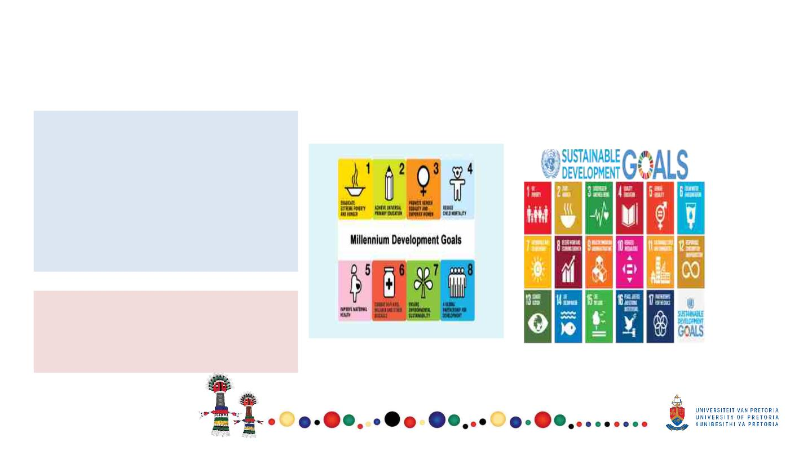
Introduction- From MDGs to SDGs
•
The agenda for MDG’s came to an
end in 2015 paving the way for
the Sustainable Development
Goals (SDG’s) with a more
transformative agenda.
SDGs set a broad agenda to
advance health and equity by
2030
8 MDGs
17 SDGs
•
• SDGs 17 goals
• 169 targets
• 244 indicators

Slide 3

Alignment
Commits to the right to equitable health
care for all South Africans and to the
progressive realisation of improvements
in access to and quality of care
Imagines a health system
that delivers good health
outcomes for the whole
population by 2030

Slide 4
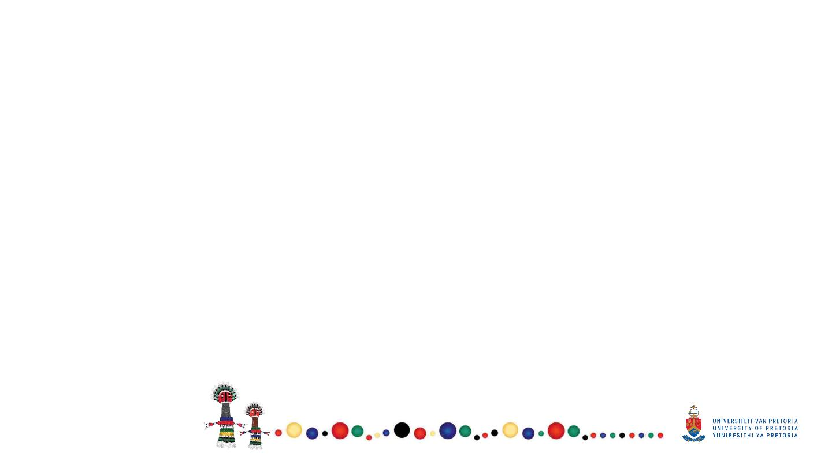
SDGs Progress 2022
§ Peace, diplomacy, and international cooperation are fundamental conditions
for the world to progress on the SDGs towards 2030 and beyond.
§ For the second year in a row, the world is no longer making progress on the
SDGs.
§ A global plan to finance the SDGs is needed.
§ At mid-point on the way to 2030, policy efforts and commitments supporting
the SDGs vary significantly across countries, including among G20 countries.

Slide 5
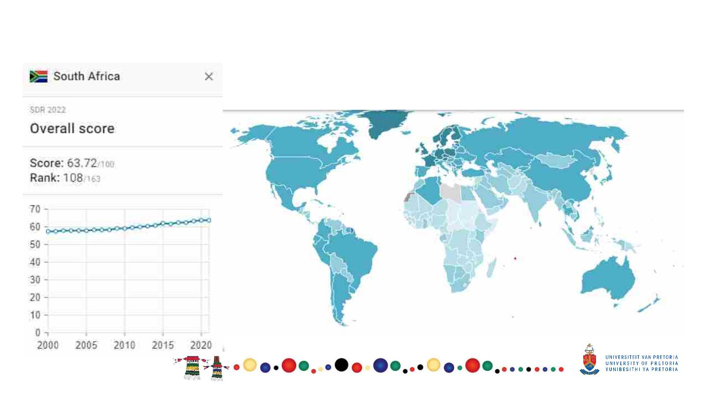
Progress: Global Rankings SA- 2022

Slide 6
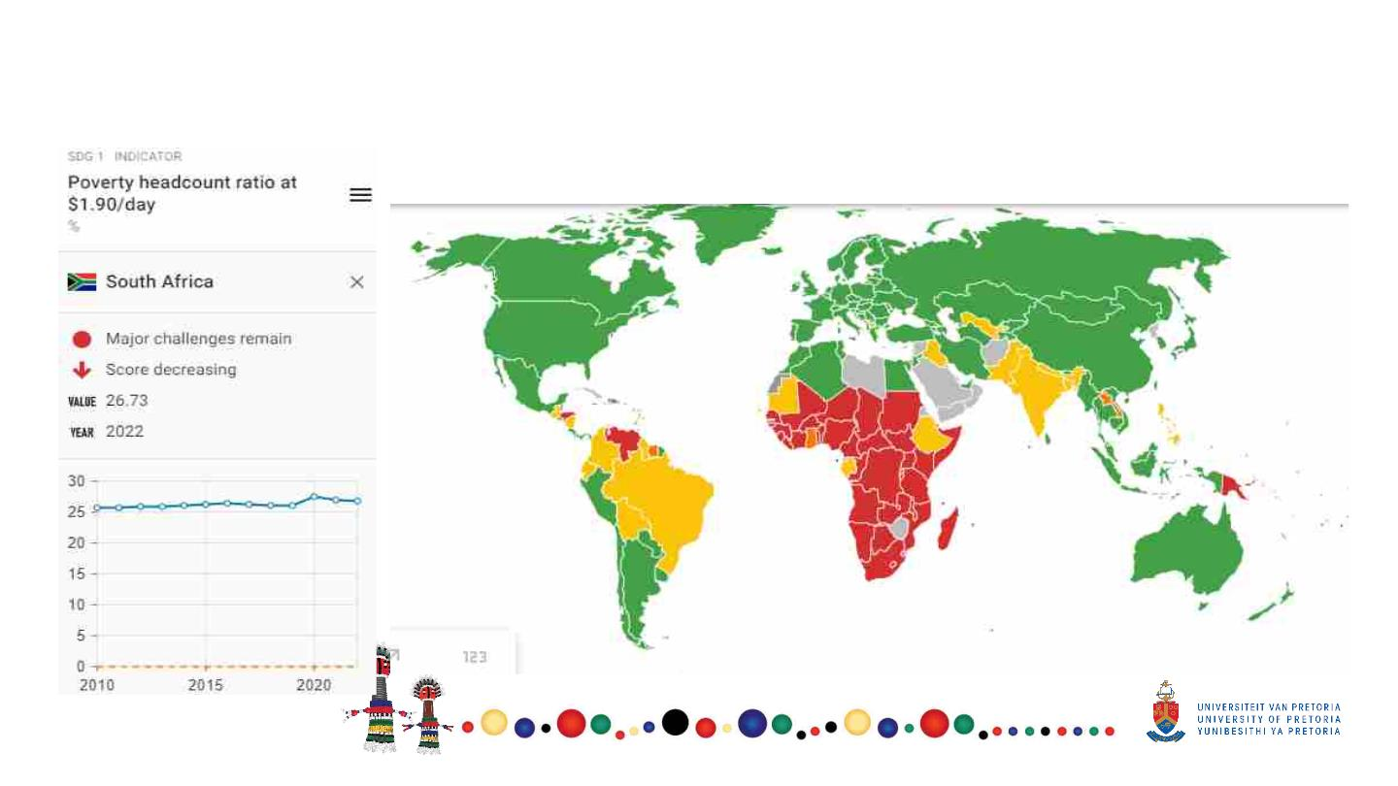
SDG 1- No poverty

Slide 7
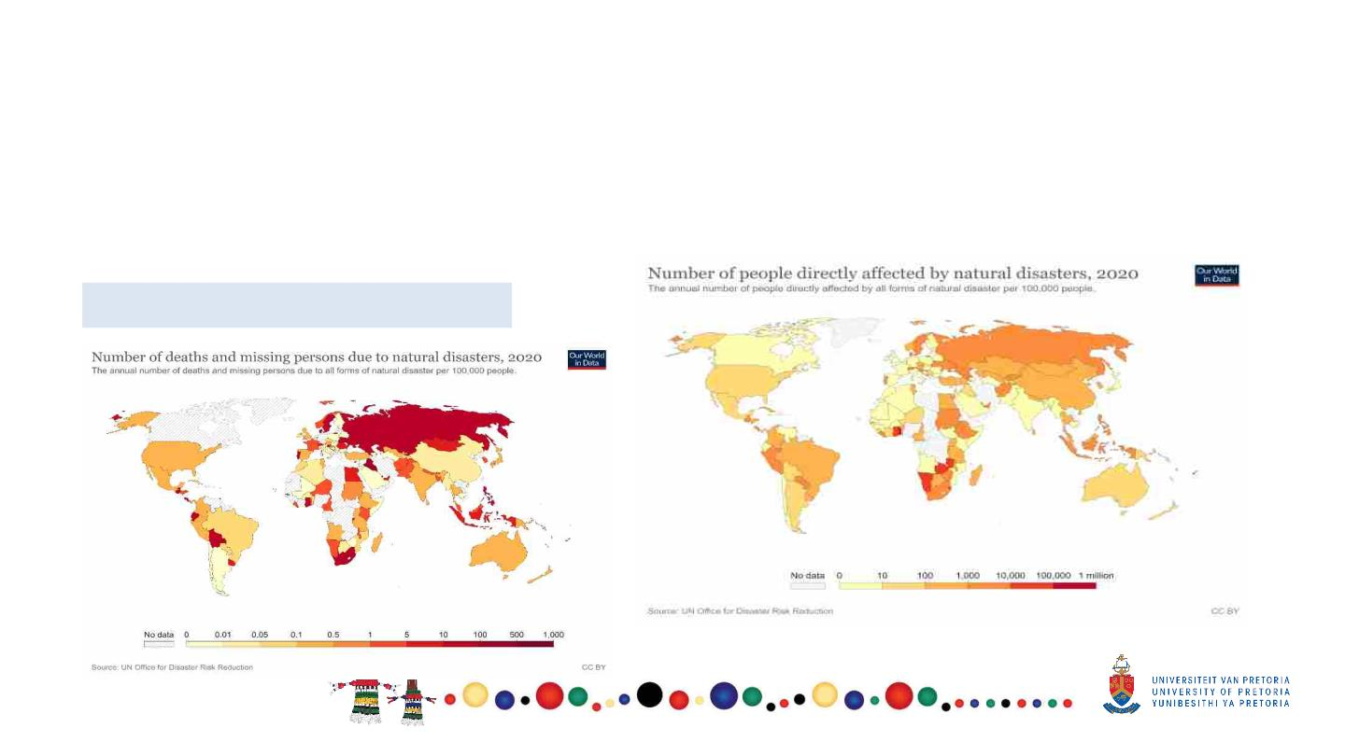
Goal 1- No poverty
End poverty in all its forms everywhere
§
Target 1.5: By 2030, build the resilience of the poor and those in vulnerable situations and reduce their
exposure and vulnerability to climate-related extreme events and other economic, social and environmental
shocks and disasters.
2020 – 48persons, SA
SA 1,752 in 2020

Slide 8
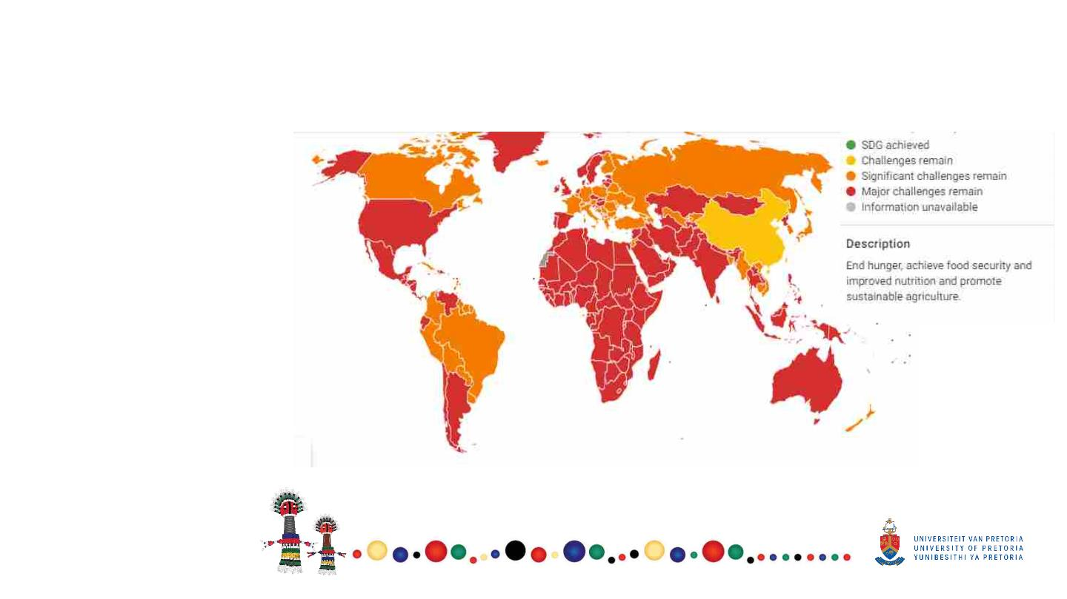
Goal 2- Zero hunger
Indicators:
•
•
•
Prevalence of
undernourishment
Prevalence of stunting in
children under 5 years of age
Prevalence of wasting in
children under five years of age
Prevalence of obesity
Human trophic levels
Cereal yield
Sustainable nitrogen
Management index
Exports of hazardous pesticides
•
•
•
•
•

Slide 9
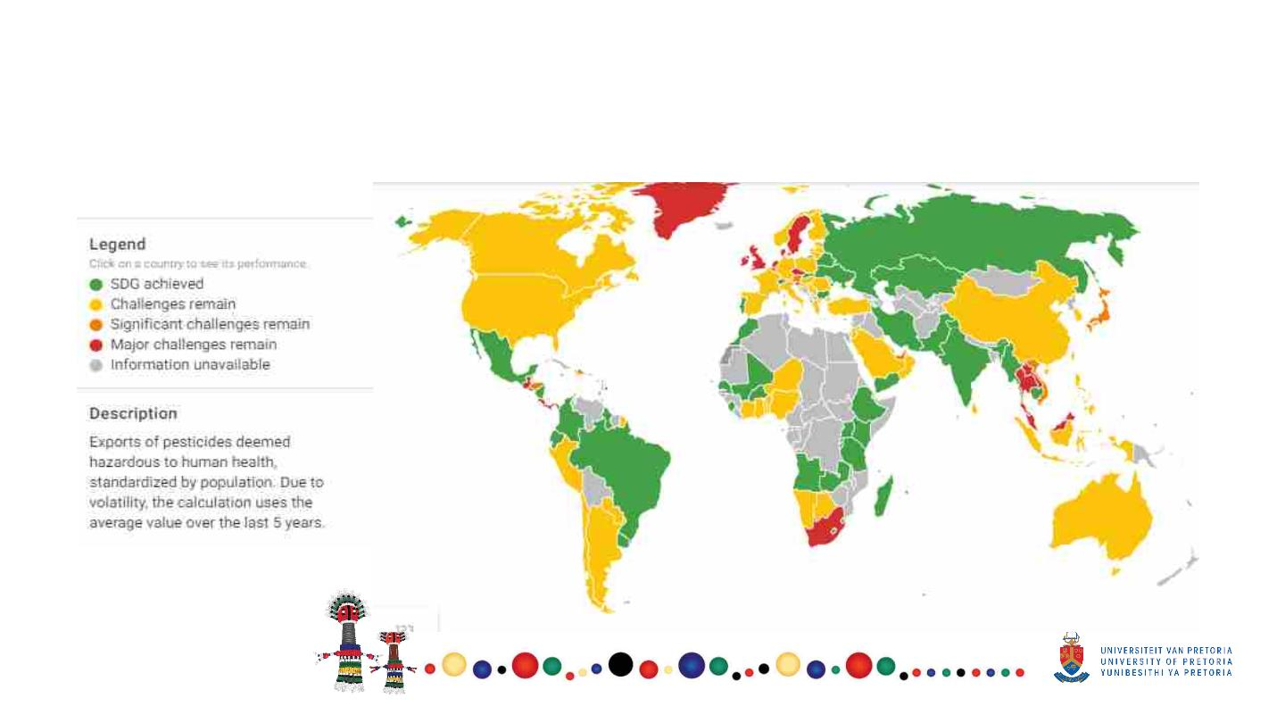
Goal 2- Zero hunger
Indicator- Exports of hazardous pesticides – tonnes per million population

Slide 10
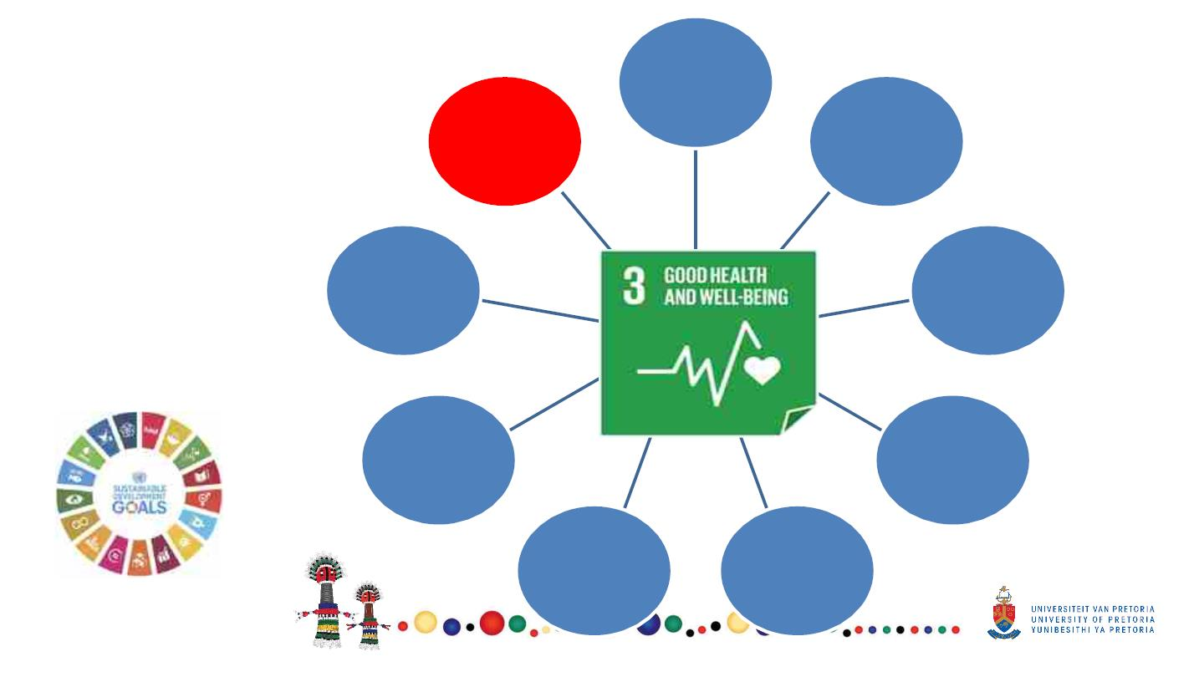
Goal 3-
targets
3.1 Reduce
maternal
mortality
3.9.
3.2. End
Hazardous
chemicals
and pollution
preventable
disease under
5 Mortality
Health targets
for SDG 3 = 13
(9 + 3 );
Indicators = 27
3.8. Universal
health
coverage
3.3. End
epidemics of
HV, TB etc
3.7. Access to
sexual and
reproductive
health
3.4 Mortality
for NCDs
3.6 Road
traffic
accidents
3.5 Substance
abuse

Slide 11
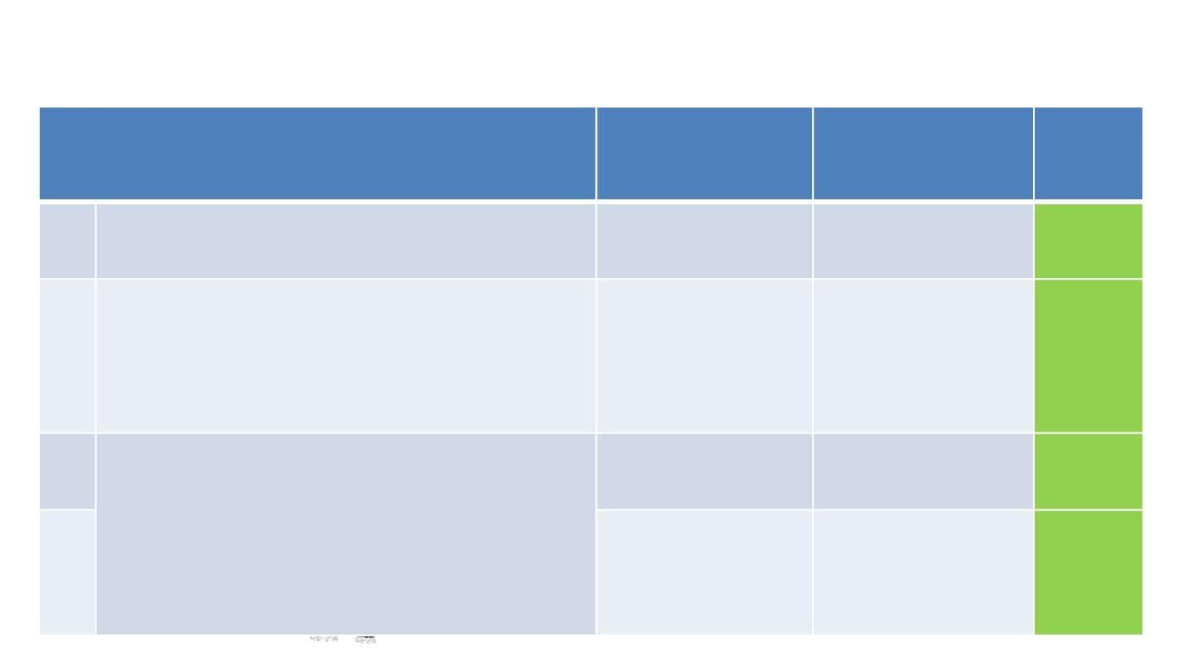
Progress SDG 3 at a glance
Target
Status as at 2015
Current status (2017 Target
unless otherwise
stated)
achieva
bility
3.1. By 2030, reduce the global maternal mortality ratio to
141 deaths per 100
000 live births
119 deaths per 100
000 live births (2017)
On track
less than 70 per 100 000 live births.
•
Indicator: 3.1.1 Maternal mortality ratio
3.2
By 2030, end preventable deaths of new-borns and 37.0 per
children under 5 years of age, with all countries aiming 1000 live births
to reduce neonatal mortality to at least as low as 12
per 1,000 live births and under-5 mortality to at least
as low as 25 per 1,000 live births
32.0 per
1000 live births
On track
•
Indicator: 3.2.1 Under‑5 mortality rate
3.3
By 2030, end the epidemics of AIDS, tuberculosis,
malaria and neglected tropical diseases and combat
hepatitis, water-borne diseases and other
communicable diseases.
15-24 years (both
sexes): 1.5 per 1000
(2008-2012)
15-24 years (both
sexes): 1 per 1000
(2012-2017)
On track
On track
15-49 years (both
sexes): 1.9 per 1000
(2008-2012)
15-49 years (both
sexes): 0.8 per 1000
(2012-2017)
• Indicator: 3.3.1 Number of new HIV infections per
1,000 uninfected population, by sex, age and key
populations

Slide 12
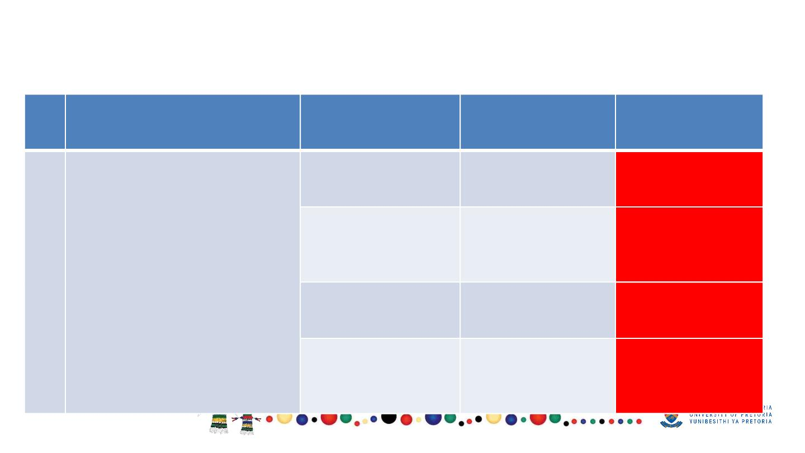
Progress SDG 3 at a glance
Target
Status as at 2015
Current status
(2017 unless
otherwise stated)
Diabetes Mellitus:
28 per 100 000
(2016 data)
Cerebrovascular
Diseases: 51 per
100 000
Target
achievability
3.4 By 2030, reduce by one third
premature mortality from non-
communicable diseases
Diabetes Mellitus:
27 per 100 000
Increasing trend,
needs special
attention
Increasing trend,
needs special
attention
through prevention and
treatment and promote mental
health and well-being.
Cerebrovascular
Diseases:
49 per 100 000
(2016 data)
Indicator: 3.4.1 Mortality rate
attributed to cardiovascular
disease, cancer, diabetes or
chronic respiratory disease
Neoplasms: 91 per
100 000
Neoplasms: 93 per
100 000
(2016 data)
Increasing trend,
needs special
attention
Diseases of
Diseases of
Increasing, needs
respiratory systems: respiratory systems: special attention
49 per 100 000
50 per 100 000
(2016 data)

Slide 13
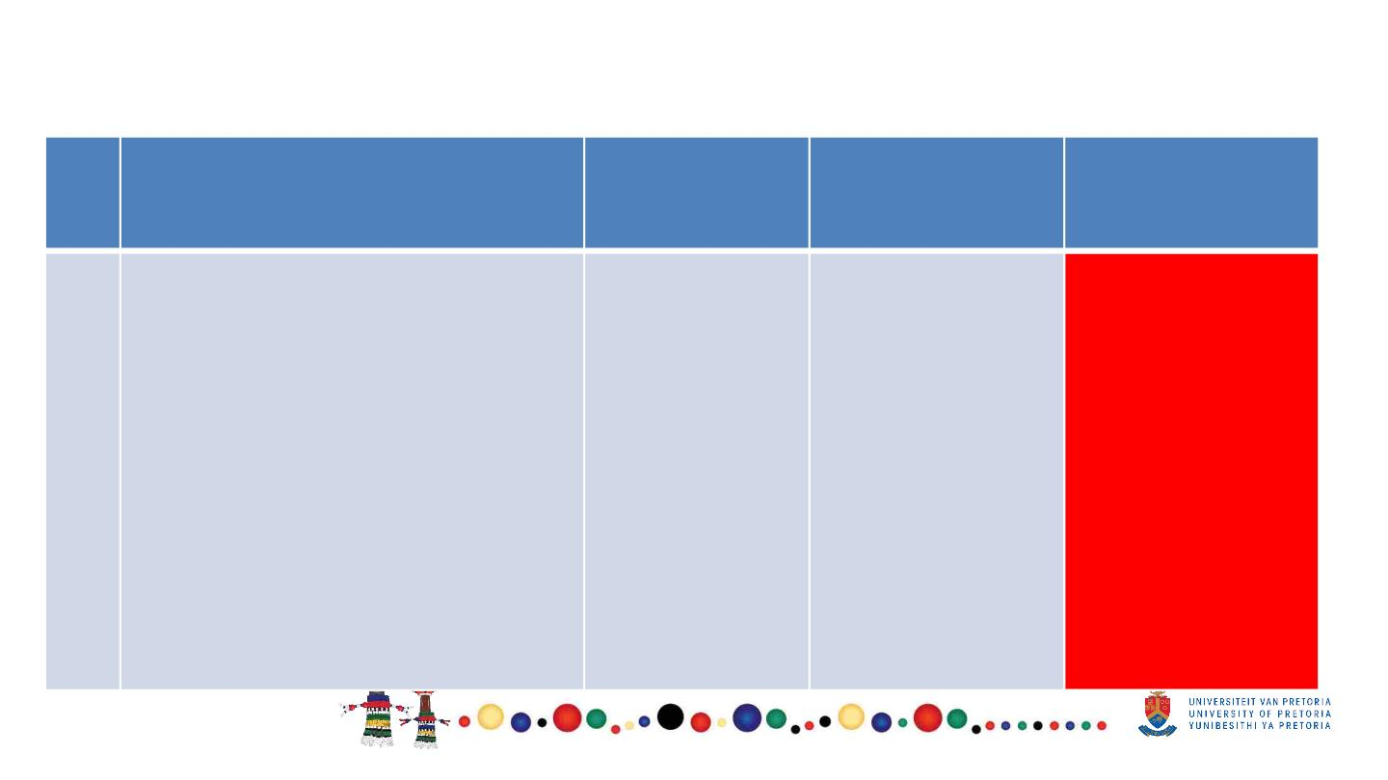
Progress SDG 3 at a glance
Target
Status as at
2015
Current status
(2017 unless
Target
achievability
otherwise stated)
3.5
Strengthen the prevention and
treatment of substance abuse,
including narcotic drug abuse
and harmful use of alcohol.
• 3.5.2 Harmful use of
7.23 litre per
capita per
annum
7.27 litre per
capita per
annum
Increasing trend,
needs special
attention
alcohol, defined according
to the national context as
alcohol per capita
consumption (aged 15 years
and older) within a calendar
year in litres of pure alcohol

Slide 14
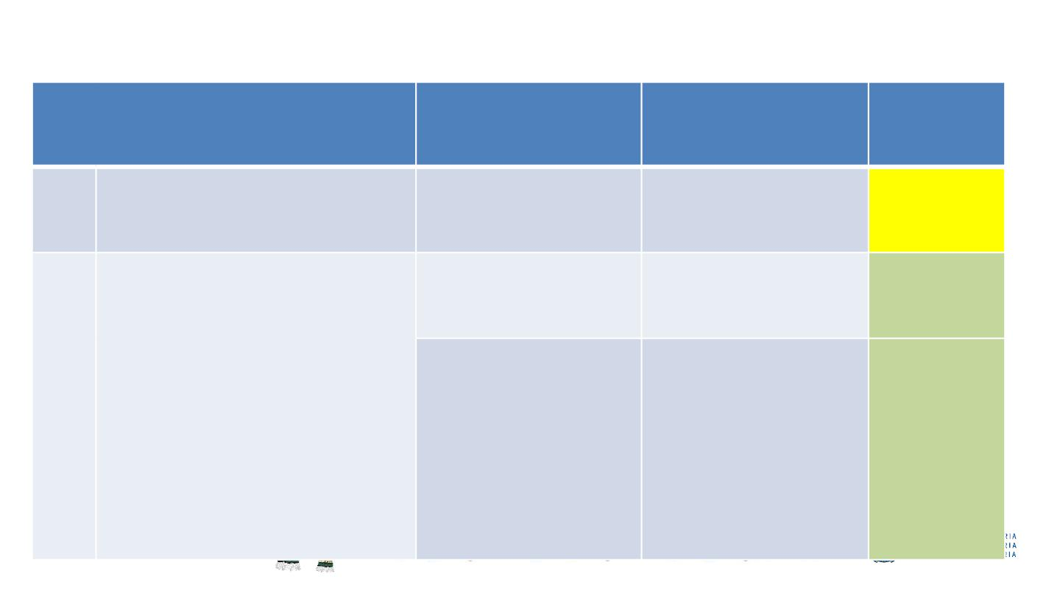
Progress SDG 3 at a glance
Target
Status as at 2015
Current status (2017
unless otherwise
stated)
Target
achievabili
ty
3.6 By 2020, halve the number of
global deaths and injuries from
road traffic accidents.
26.0 fatality rate per
1000 000 population
22.22 fatality rate per
1000 000 population
(2019)
Some
progress
3.7 By 2030, ensure universal
access to sexual and
10-14 years
1.4 per 1000
10-14 years 0.6 per
1000
On track
On track
reproductive health-care
services, including for family
planning, information and
education, and the integration of
reproductive health into national
strategies and programmes.
3.7.2 Adolescent birth rate
(aged 10–14 years; aged 15–
19 years) per 1,000 women in
that age group
15-19 years 64.7 per
1000
15-19 years 46.2 per
1000

Slide 15
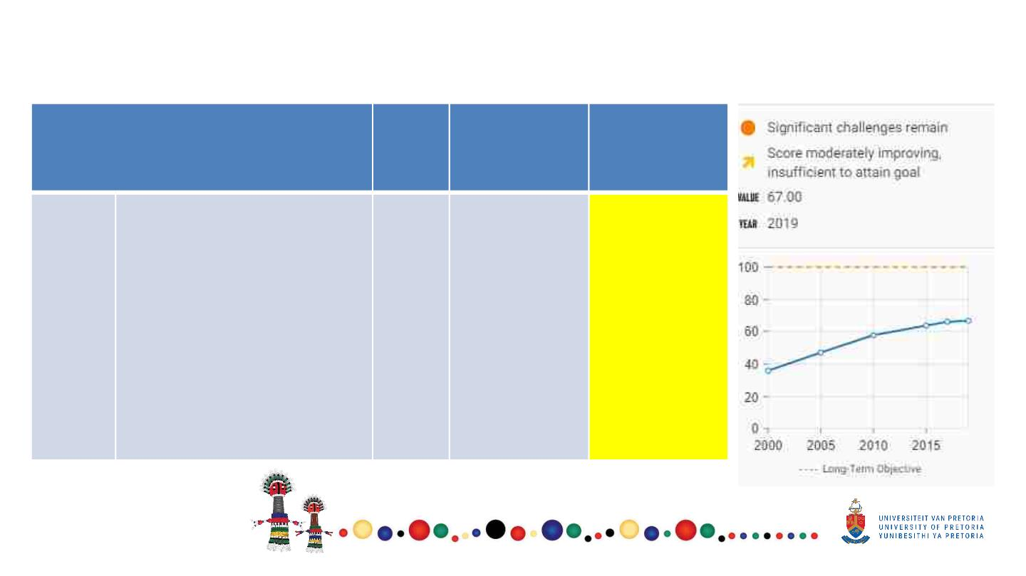
Progress SDG 3 at a glance
Target
Status Current status
Target
achievability
as at
2015
(2019 unless
otherwise
stated)
3.8
Achieve universal health
coverage, including financial
risk protection, access to
quality essential health-care
services and access to safe,
effective, quality and affordable
essential medicines and
vaccines for all.
-
67.2%
Some progress
•
Indicator 3.8.1 Coverage
of essential health
services

Slide 16
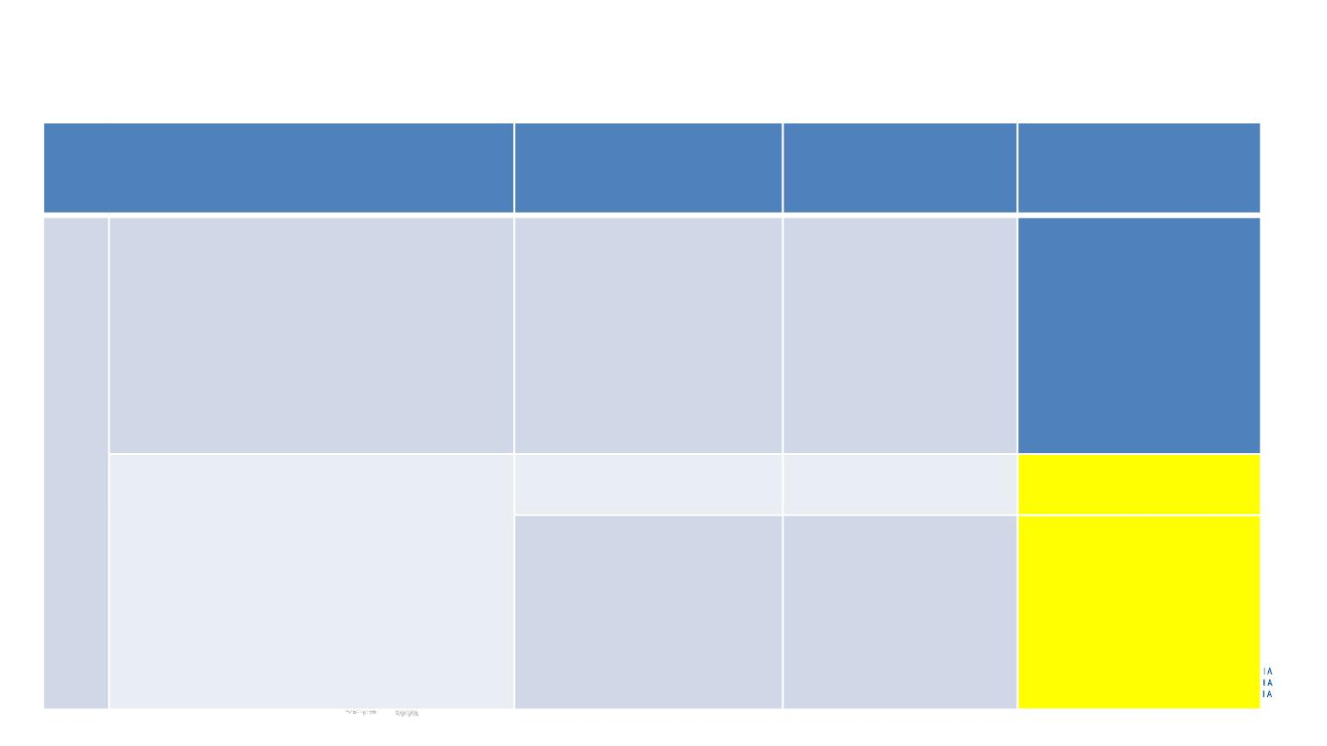
Progress SDG 3 at a glance
Target
Status as at 2015
Current status
(2017 unless
Target
achievability
otherwise stated)
0.2 deaths per 100
000 (2015)
3.9
By 2030, substantially reduce the
number of deaths and illnesses
from hazardous chemicals and air,
water and soil pollution and
contamination.
0.4 deaths per 100 000
(2013)
No official current data
for 2016/17
• Indicator 3.9.3 Mortality rate
attributed to unintentional
poisoning
3.a Strengthen the implementation of
the World Health Organization
Framework Convention on Tobacco
Control in all countries, as appropriate.
Male: 42% (1998)
Male: 37% (2016)
Female: 7% (2016)
Some progress
Some progress
Female: 11% (1998)
• Indicator 3.a.1 Age standardised
prevalence of current tobacco use
among persons aged 15 years and
older

Slide 17
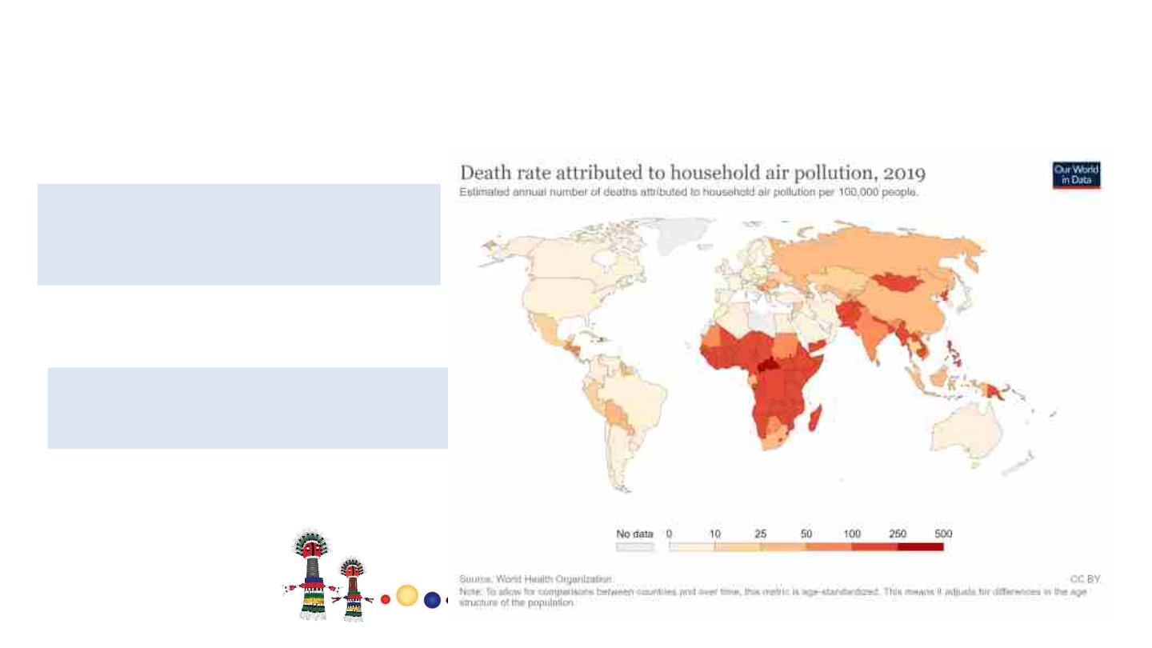
Goal 3 – Good health and well being
Ensure healthy lives and promote well-being for all at all ages
§
Target 3.9: substantially reduce
illnesses and deaths from
hazardous chemicals and
pollution
Mortality rate from air pollution
South Africa = 82 deaths per
100 000 population

Slide 18
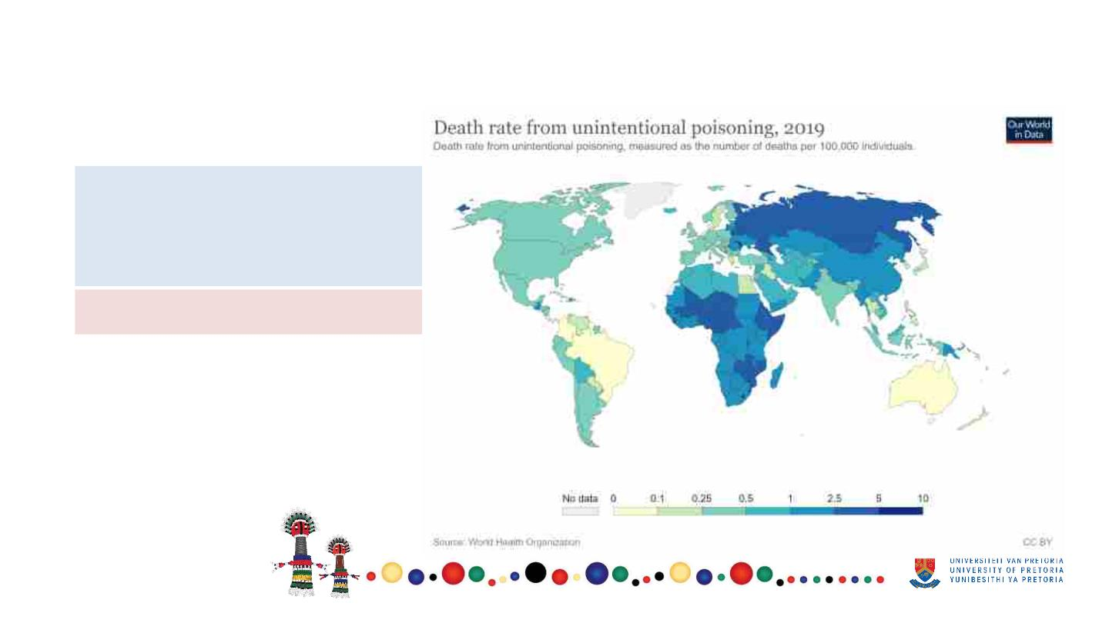
Goal 3 – Good health and well being
§ Mortality rate attributed to
unintentional poisoning
2019 South Africa – 1.70

Slide 19
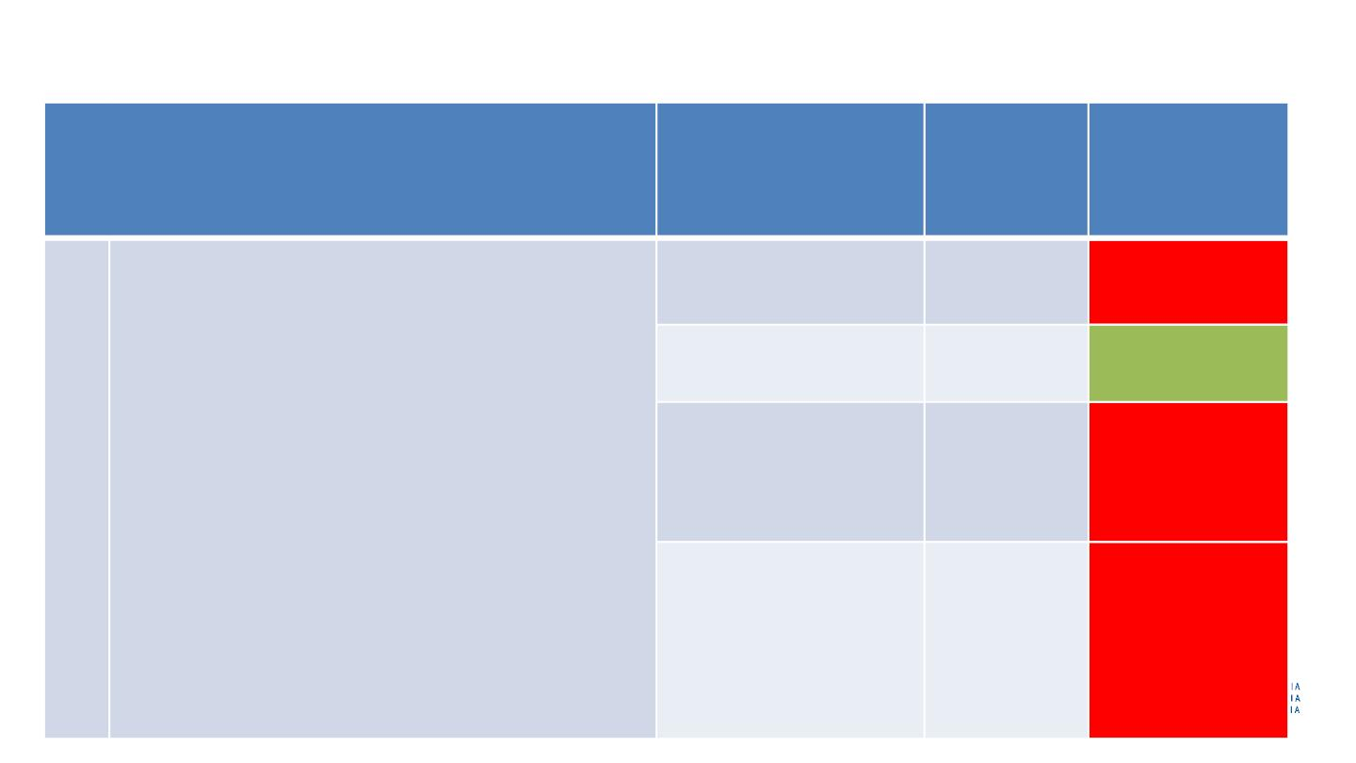
Progress SDG 3 at a glance
Target
Status as at 2015
Current
status
Target
achievability
(2017 unless
otherwise
stated)
3.9
3.b Support the research and development of
vaccines and medicines for the communicable and
non‑communicable diseases that primarily affect
developing countries.
- Provide access to affordable essential medicines
and vaccines, in accordance with the Doha
Declaration on the TRIPS Agreement and Public
- Health, which affirms the right of developing
countries to use to the full the provisions in the
Agreement on Trade-Related Aspects of
Intellectual Property Rights regarding flexibilities
to protect public health, and, in particular, provide
access to medicines for all.
DTP
(3rd dose): 94,2%
84.1%
Declining, needs
special attention
Measles
(2nd dose): 74,5%
77.6%
78.8%
On track
Pneumococcal
conjugate vaccine
(last dose in schedule):
85,2%
Declining, needs
special attention
HPV vaccine
(last dose in schedule):
63,6%
61.4%
Declining, needs
special attention
•
Indicator: 3.b.1: Proportion of the target
population covered by all vaccines included in
their national programme

Slide 20
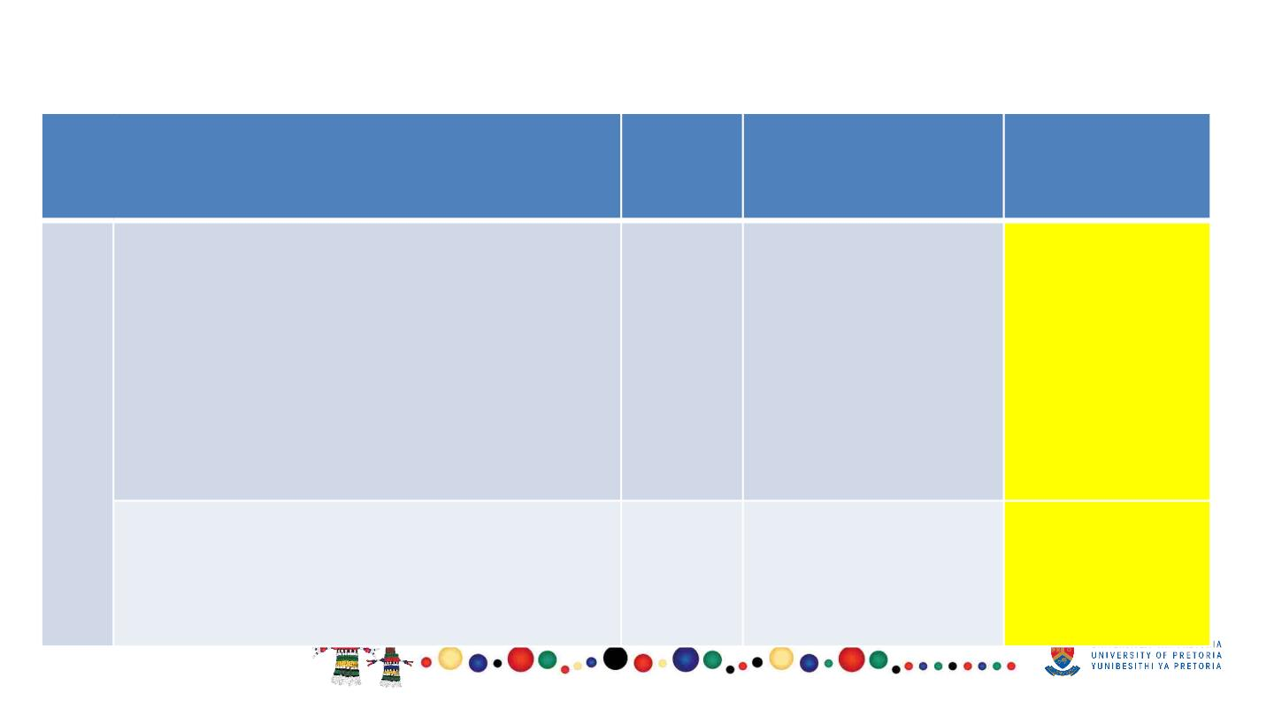
Progress SDG 3 at a glance
Target
Status as
at 2015
Current status (2017
unless otherwise
stated)
Target
achievability
3.9
3.c Substantially increase health financing
and the recruitment, development, training
and retention of the health workforce in
developing countries, especially in least
developed countries and small island
developing States
-
Progress made in
various categories
e.g. annual increase
in medical
Some progress
practitioners is 5.30%
•
3.c.1 Health worker density and
distribution
3.d Strengthen the capacity of all countries,
in particular developing countries, for early
warning, risk reduction and management of
national and global health risks
-
Early warning
systems developed
Some progress

Slide 21
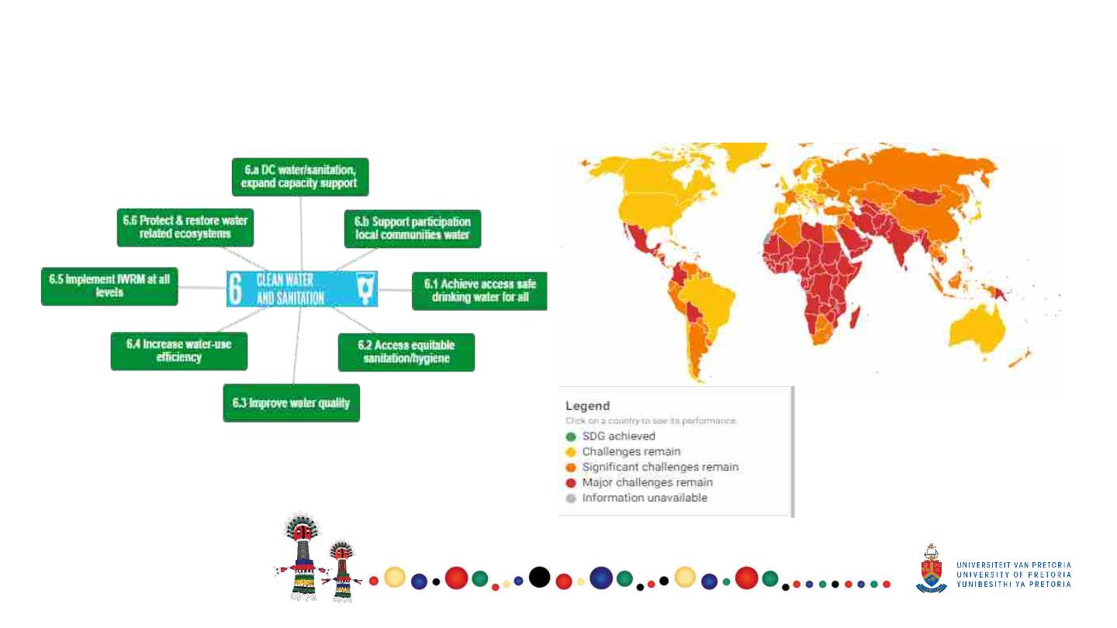
Goal 6 – Clean water and sanitation

Slide 22
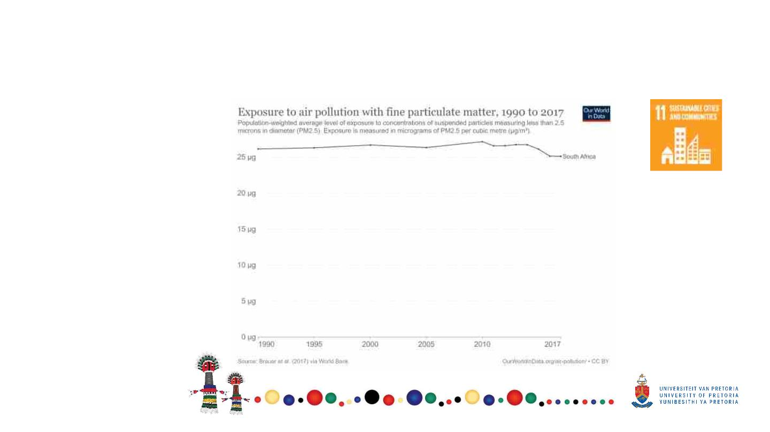
Goal 11- Sustainable cities and communities
Make cities inclusive, safe, resilient and sustainable impacts of cities
Target 11.6 Reduce the
environmental impacts of
cities – air quality and
municipal and other
waste management
Target 11.b-policies and
plans towards inclusion,
resource efficiency,
mitigation and adaptation
to climate change,
resilience to disasters

Slide 23
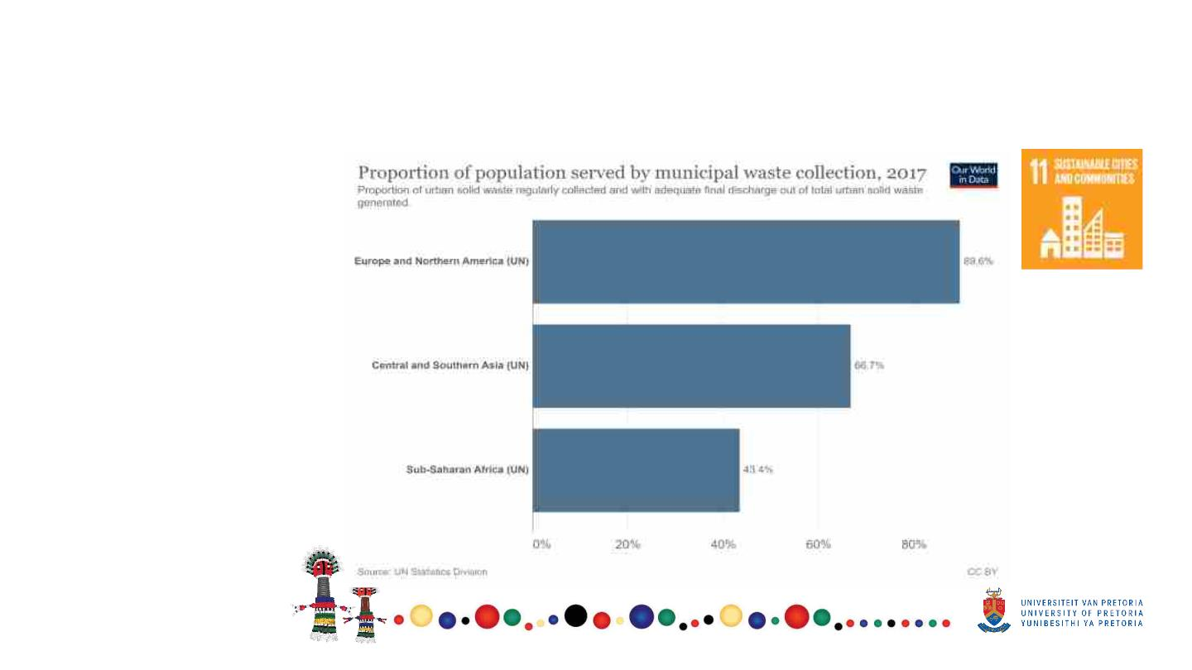
Goal 11- Sustainable cities and communities
Make cities inclusive, safe, resilient and sustainable impacts of cities

Slide 24
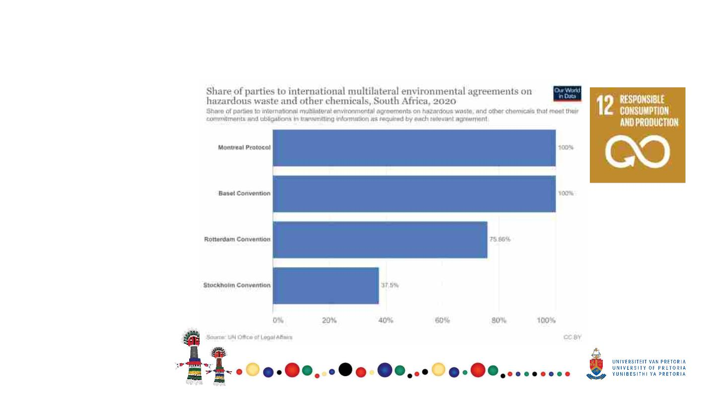
Goal 12- responsible consumption and production
Ensure sustainable consumption and production patterns
International
agreements on
hazardous waste

Slide 25
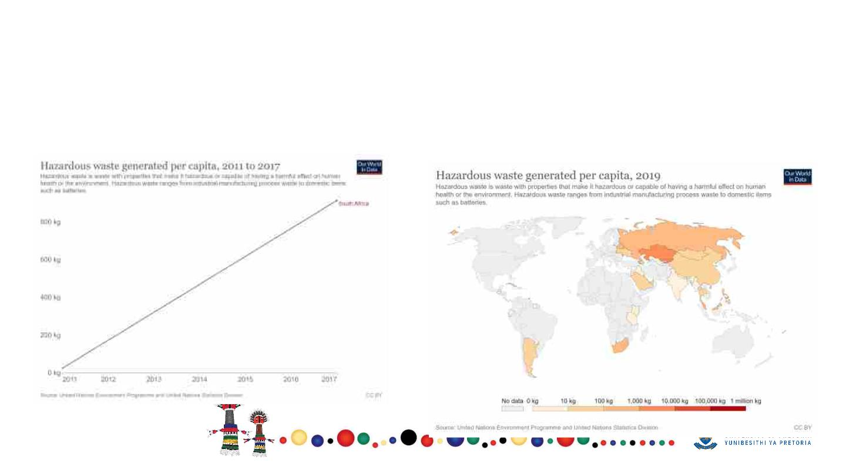
Goal 12- responsible consumption and production
Ensure sustainable consumption and production patterns
Hazardous waste generation

Slide 26
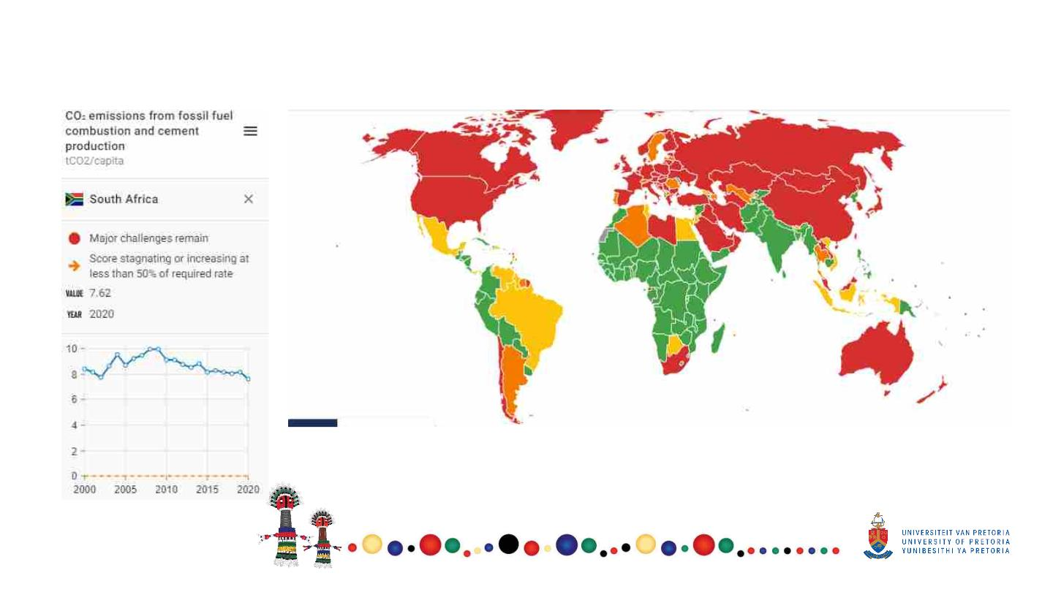
Goal 13- climate action

Slide 27
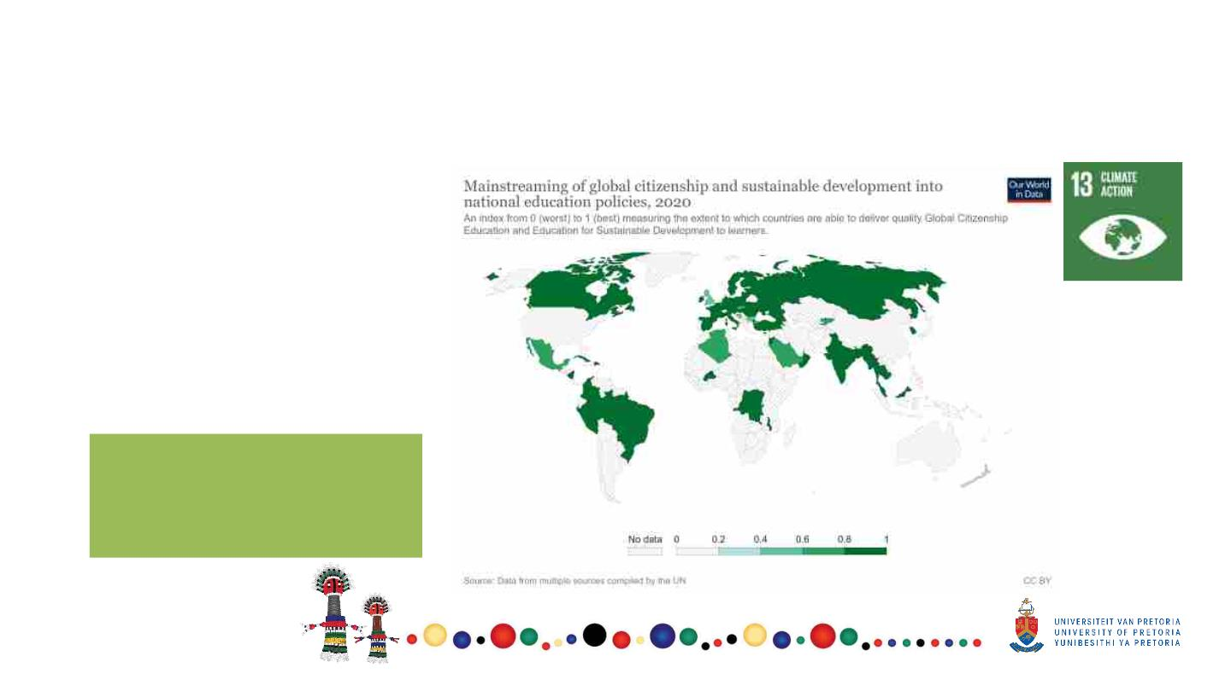
Goal 13 – Climate action
Take urgent action to combat climate change and its impacts
•
Target 13.1: Strengthen resilience
and adaptive capacity to climate-
related disasters
•
Target 13.2: Integrate climate
change measures into policy and
planning
•
•
Target 13.3: Build knowledge and
capacity to meet climate change
Target 13a and 13b
SA - No data available in
2020 for most of the
targets

Slide 28
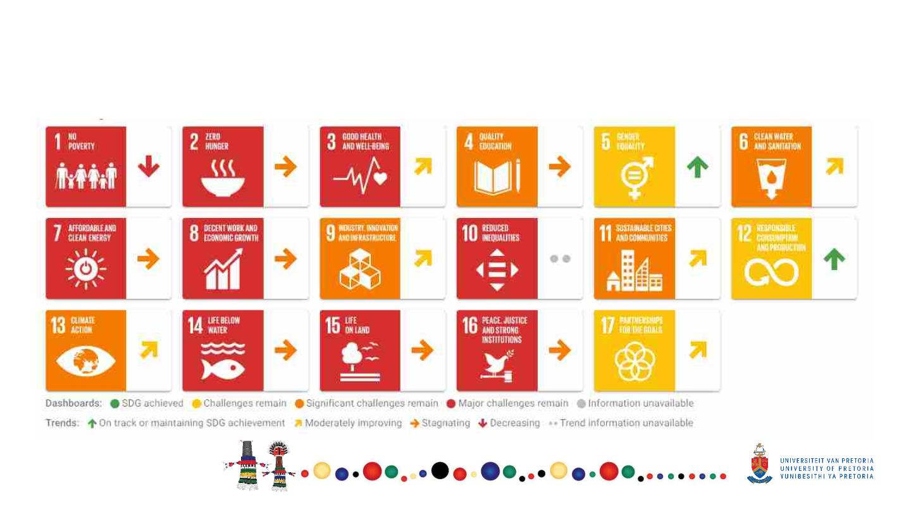
SDG Dashboard and trends: SA
SDG Dashboards and Trends

Slide 29
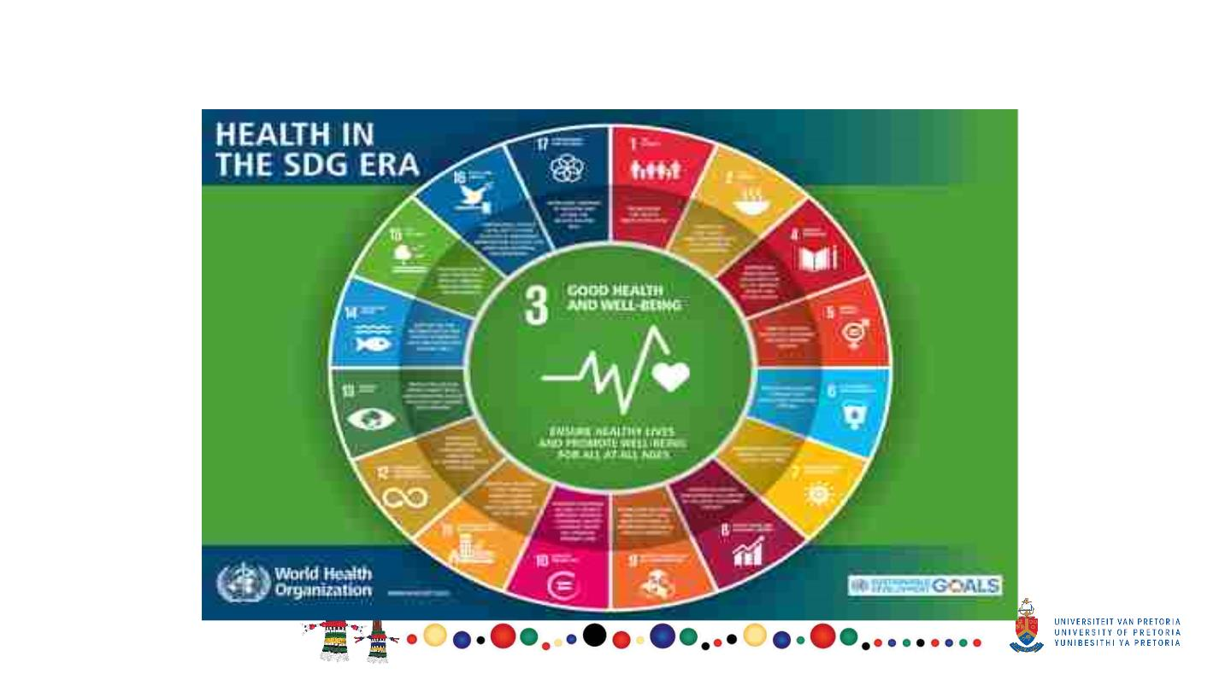
Goal 3 at the centre of the SDG’s

Slide 30
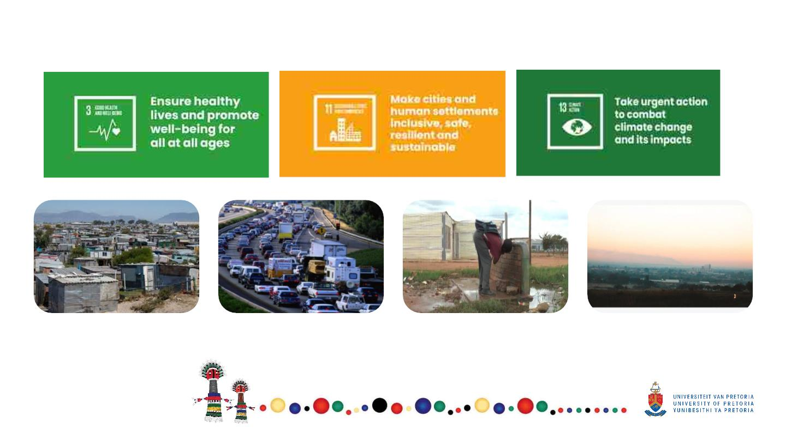
Example: Interlinkages- Goals
Housing
Transport
Water and sanitation
Air pollution
•More than 100 000 deaths due to
inadequate housing
•Inadequate water and sanitation and
hygiene cause an estimated 10 diarrhea
deaths per day in low and middle income
countries

Slide 31
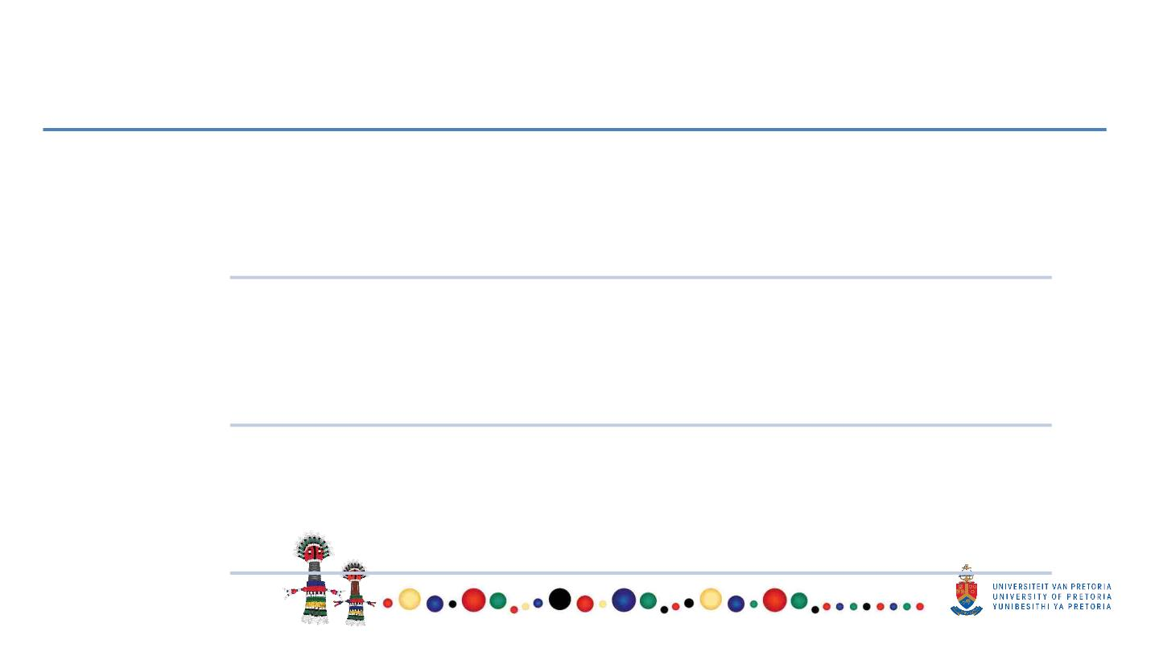
All in all……
There is evidence that South Africa is making some progress in
improving health
The health systems and socio-economic factors responsible
for the progress in health indicators observed in the MDG era
remain in place.
The country needs to identify and strengthen
implementation of key health and non health interventions

Slide 32
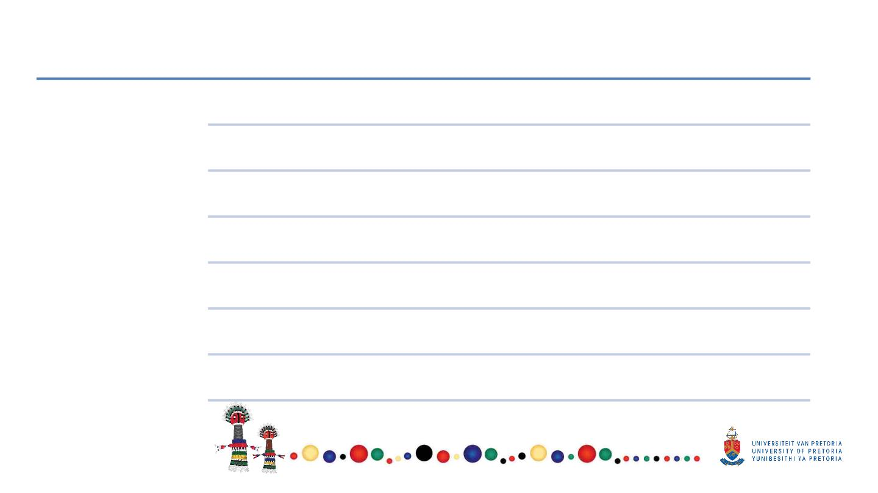
Priorities and accelerators
Beyond
Innovative and sustainable health financing
strengthening the
building blocks of
the health service,
the priorities and
accelerators
towards the
attainment of
health SDG targets
can be categorised
into the following
Frontline health care services
Community and civil society engagements
Environmental and Social determinants of health
Research and development
Data management and digital health
Target prevention and care towards reducing the quadruple burden
of disease

Slide 33

Recommendations
Strengthening high impact Interventions at health program level
Evaluate policy impact
Invest in addressing environmental and social determinants of health
Strengthen environmental health services
Data gaps- Reporting – decide on how data will be collected
Address burden of disease
Funding, Monitoring and evaluation
Involve people at local level – they must understand how the SDGs are linked to their day to day
work
Alignment of global indicators – country level indicators

Slide 34
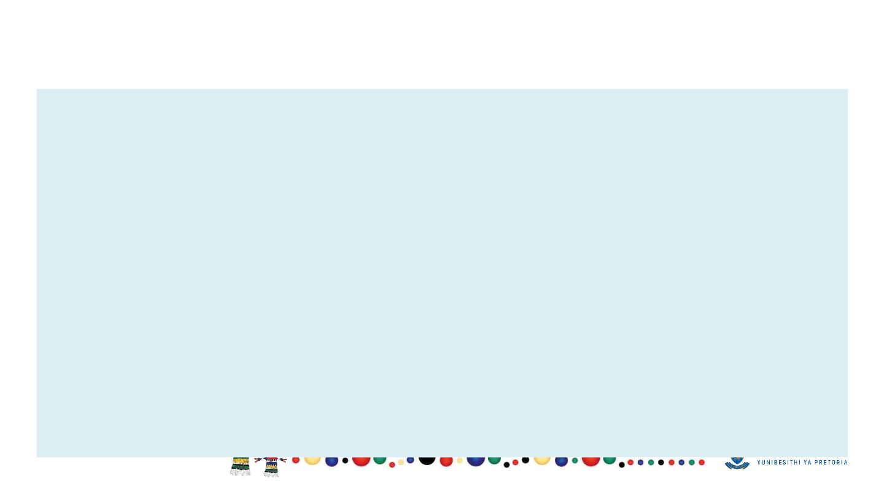
Conclusion
§ South Africa has made progress in line with the SDG 3 targets and indicators since 1994
but still has work to do to realise a number of the targets. Although the health system is
still inequitable, progress is being made towards Universal Health Coverage (UHC) with
the introduction of National Health Insurance (NHI).
§ As for most low and middle income countries, data gaps exist, that need to be filled
through strengthening of routine health information systems, surveillance systems and
targeted research. With data availability, it will be possible to explore underlying
inequities through disaggregation of the data.

Slide 35
Acknowledgements
§ Statistics South Africa (STATS SA)
§ University of Pretoria – SDG Hub
§ School of Health Systems and Public Health, UP

Slide 36
References
§ Sachs, J., Lafortune, G., Kroll, C., Fuller, G., Woelm, F. (2022). From Crisis to Sustainable
Development: the SDGs as Roadmap to 2030 and Beyond. Sustainable Development Report
2022. Cambridge: Cambridge University Press.
§ WHO: https://unstats.un.org/sdgs/indicators/database/?indicator=3.9.1

Slide 37

Thank You
Joyce.Shirinde@up.ac.za

